Slide 1
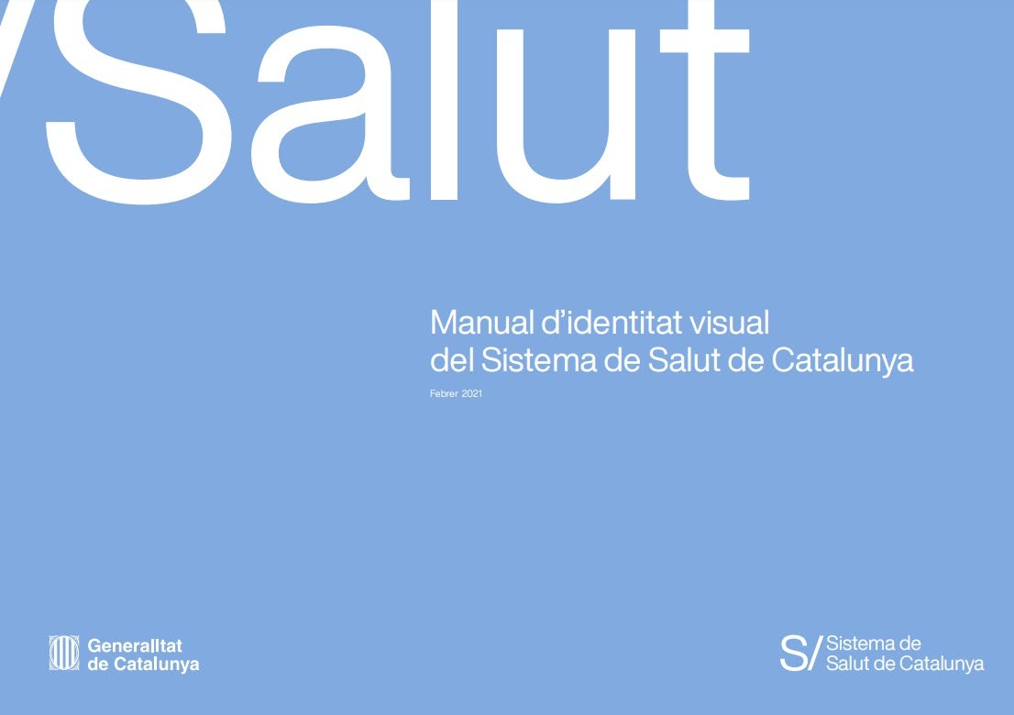
Powering the Catalan Health System
transformation
The Digital Health Strategy for Catalonia
1

Slide 2
First part: let’s talk about data

Slide 3
Highlights on Catalan Health System
7,722,203
Population in Catalonia on January 1, 2020.
Universal coverage
The publicly health care system of Catalonia was founded in 1990 under the principle of universality; so all individuals and communities are able to receive the health services.
14,000 M€
Catalan Health Service budget for 2020. The system is funded from general taxation and government founds and contributions.
> 160
Health care entities to provide health care services.
>16,000
Applications across the Catalan Health System:
1 EMR for primary care.
> 29 EMR products in the Intermediate care hospitals.
At least 10 different systems for social care records.
940
Facilities that range from primary health care centres to hospitals and intermediate care centres.

Slide 4
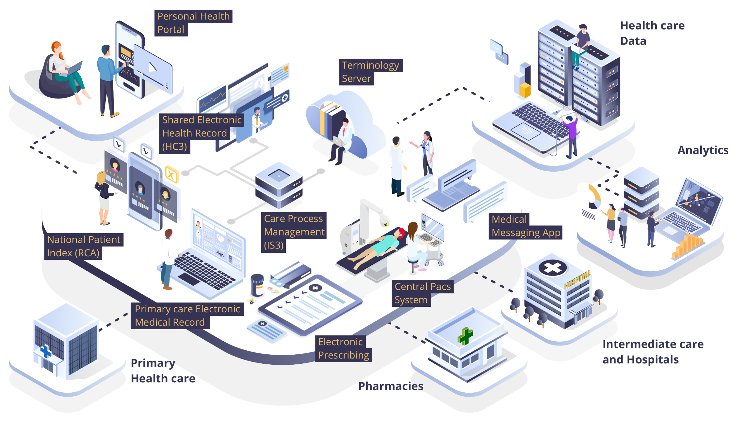
The Catalonian Digital Health Platform (1)

Slide 5
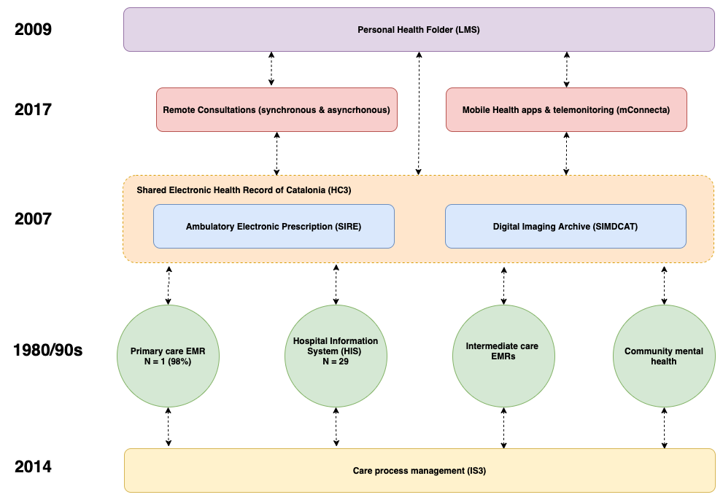
The Catalonian Digital Health Platform (2)

Slide 6
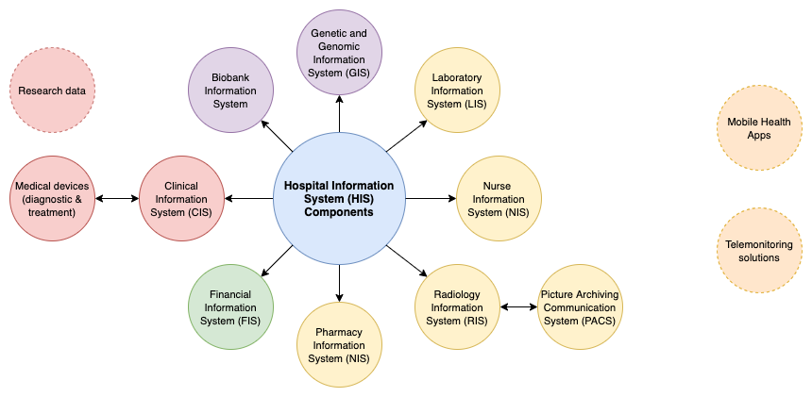
Service provider level – Understanding the Electronic Medical Records

Slide 7
A huge heterogeneity of data models
71 hospitals and 29 different vendor products
Each tertiary hospital has around 800 silos of information
Each secondary hospital has around 400 silos of information
Our prospections indicate us we have more than 16k silos of patient related information being the EMRs the biggest source (and growing fast due to digital health solutions)
Huge heterogeneity of proprietary data models

Slide 8
Health care platforms in Catalonia
Personal Health Portal (LMS)
> 5,7 M citizens
Social care records systems
Central PACS System (SIMDCAT)
> 5,000 M images
Primary care
EMR (1 product)
Electronic Prescribing
(SIRE)
416 M of prescriptions
37,000 health care professionals as users
1,346 M dispensing of medicines
late 80s
early 90s
2000
2006
2007
2009
2014
2018
2020
Care Process Management (IS3)
> 15,6 M referrals
Hospitals intermediate care EMRs (29 products)
Shared Electronic Health Record (HC3)
> 1,000 M documents
> 70% structured information
Remote Consultations
> 15 M
National Patient Index
(RCA)
7,697,069 people (2021)
+ 43,224 previous year

Slide 9
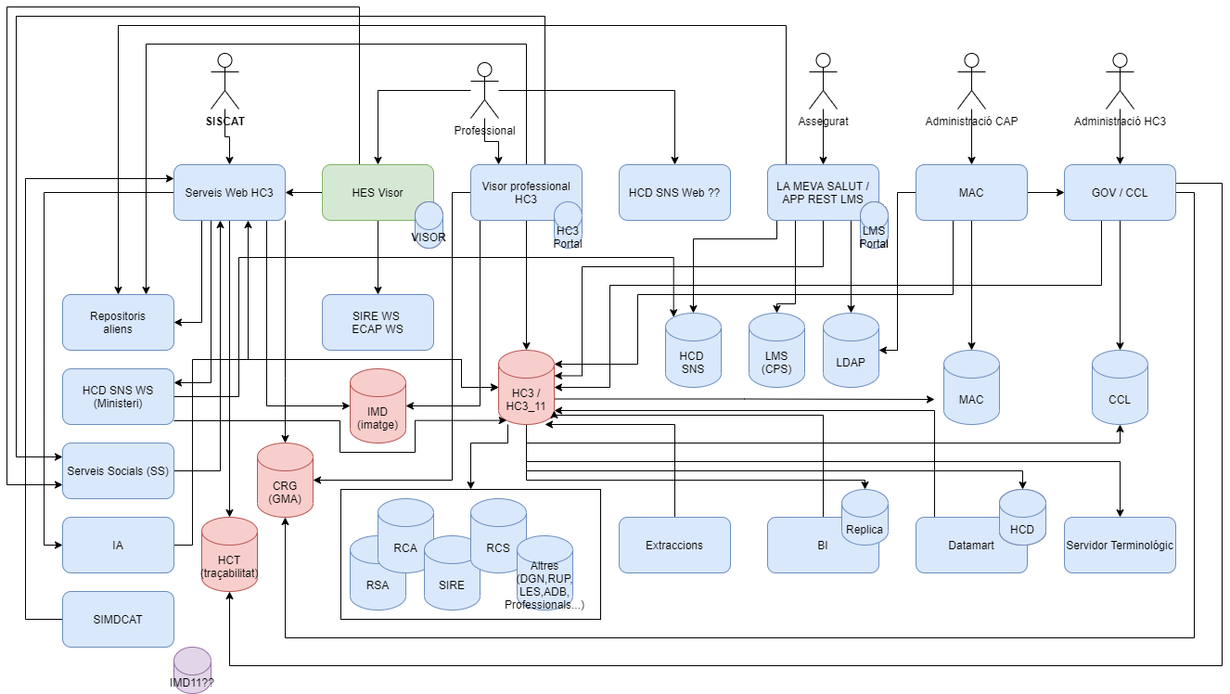
The Shared Electronic Health Record of Catalonia – Systems Architecture

Slide 10
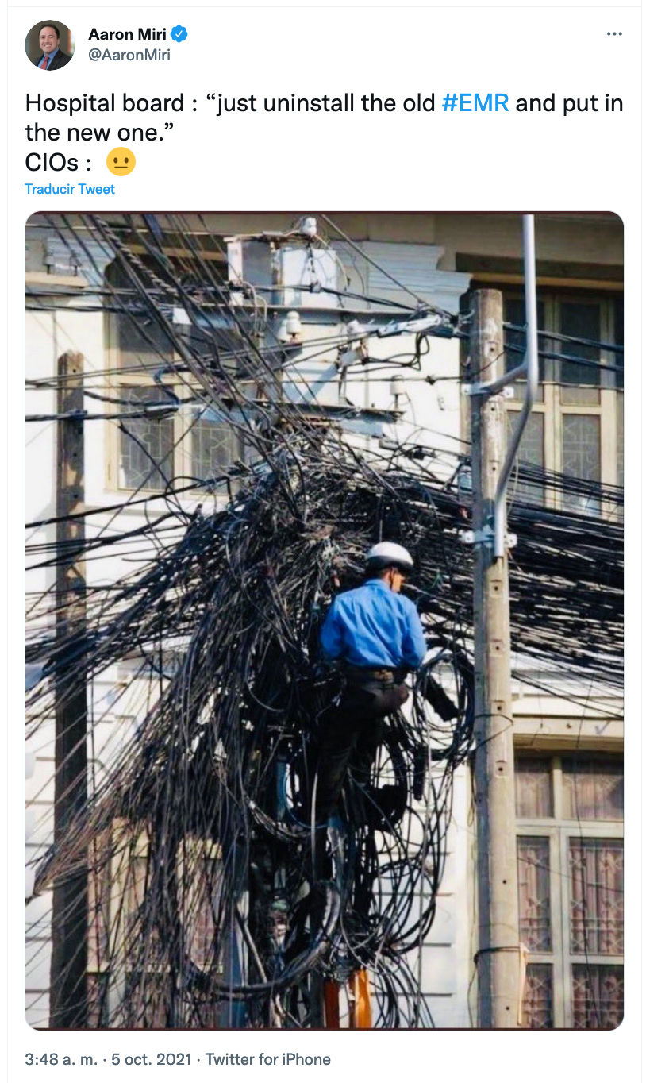
We are not alone within this journey…

Slide 11
Second part: let’s talk about the future

Slide 12
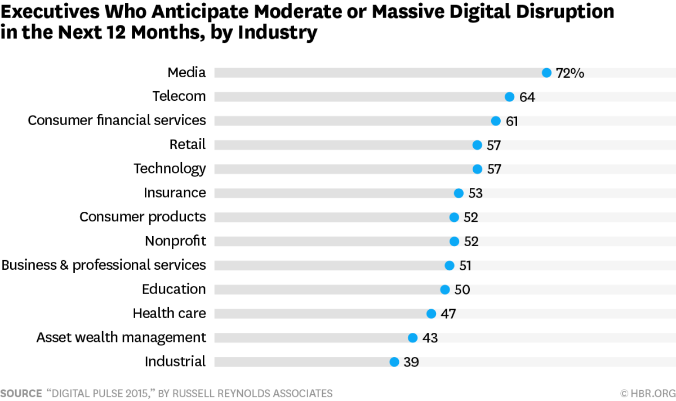
Understanding the digital transformation
First wavers: products & services easy transformed to digital (costs of extra unit and distribution almost equal to 0)
Second wavers: traditional sectors where physical dimension will be always important
Health ranks within the lowest third of industries in digital maturity

Slide 13
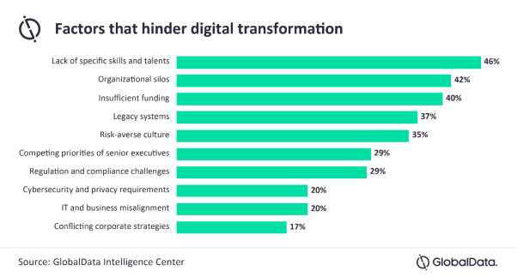
Barriers towards the adoption of digital health (2)
Barriers for the adoption of digital health are non-technological but organizational and cultural
The top ranked barrier is the lack of skills of healthcare professionals (from C-suite to frontline workers) but the 4th are legacy systems!

Slide 14
Limitations of the current information systems model
Broad ecosystem of applications with buried business logic and data models.
Old-fashioned solutions and a dramatic increase in technical debt.
Communication between service providers and the NHS through static and incoherent interoperability solutions.
High costs for maintenance, corrective and evolutionary development.
Difficulties to scale-up innovations and best practices.
Rigid model that does not foster adaptation to change.

Slide 15
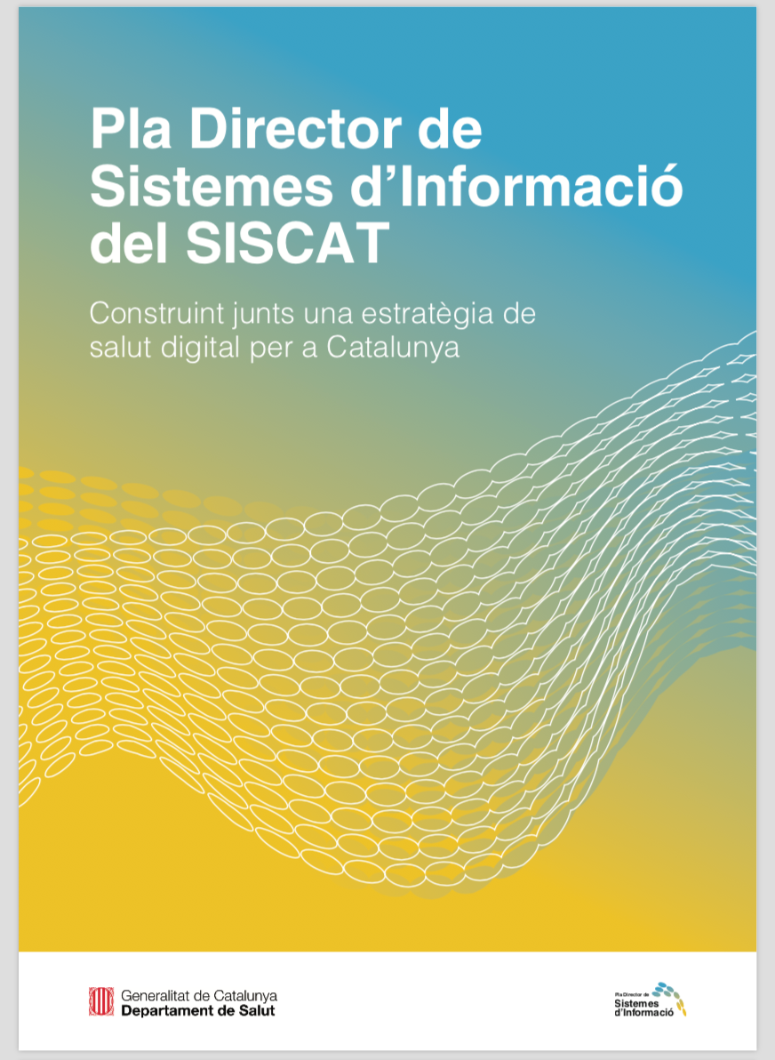
Catching up the time: Digital Health Strategy for Catalonia

Slide 16
Master Plan Goals
Consolidate a person-centred model of information systems that enables clinical and managerial decision-making across the care cycle.
Establish a governance model of information systems with a solid community support while ensuring care continuity.
Set out a financing framework to ensure implementation and sustainability over time.
Create environments and opportunities to design and implement innovative person-centred ICT-based care services.
Set out an ambitious roadmap, yet realistic, which will allow a long-lasting, successful and safe implementation of the new model.

Slide 17
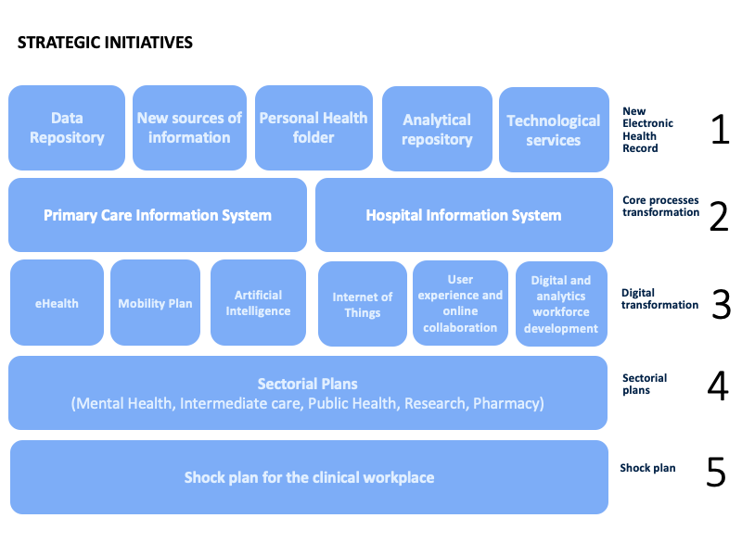
Digital Health Strategy for Catalonia

Slide 18
A unique Electronic Health Record
The longitudinal Electronic Health Record (HES) is the main piece of the SISCAT Information Systems Master Plan and represents the functional and technical repository of all the information of the citizen that must be registered and shared throughout the health system.
It is not just, or mainly, a technological update, but a model for data management and an architecture of information systems that corresponds to and anticipates the changes that are taking place in the healthcare model in:
citizen's relations with the healthcare system
work processes
relations between the professionals themselves
Mechanisms are also envisaged to intensify collaboration between the different actors in the healthcare system, to define semantic and technical standards and to share and take advantage of technological innovation.

Slide 19
What is this all about?

Slide 20
The open platform paradigm

Slide 21
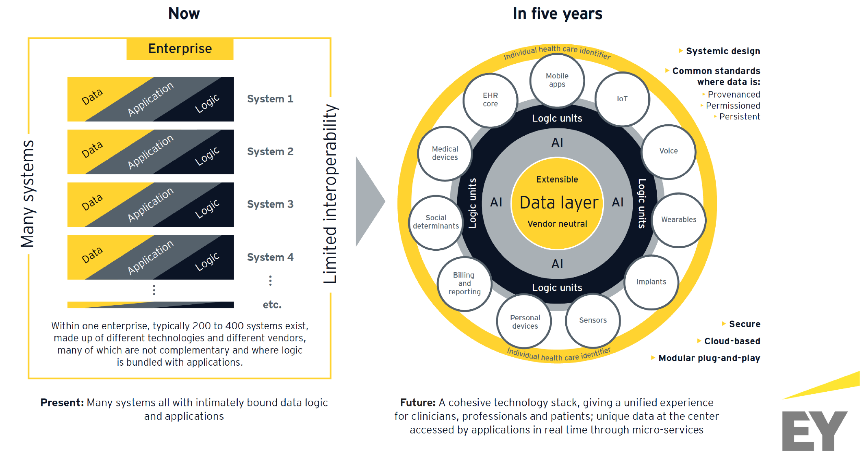
Current vs future view

Slide 22
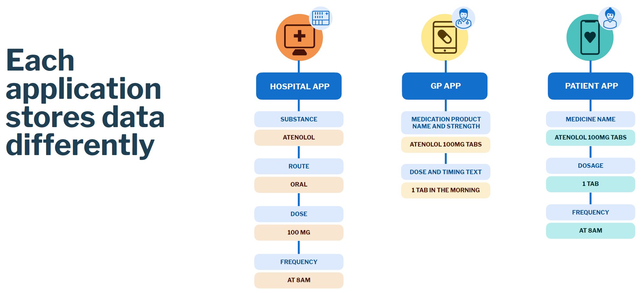
More in depth… Current situation

Slide 23
More in depth… Current situation

Slide 24
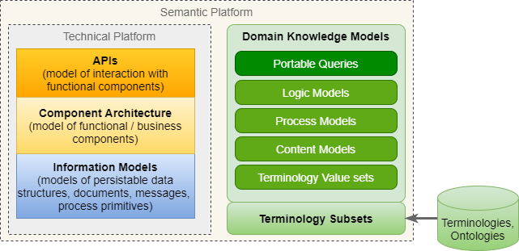
What is a knowledge-driven platform?
The aim of such a platform is to allow health professionals to structurally represent their knowledge with a longitudinal vision. This representation becomes requirements for software development (transactional and informational) in an automated manner
Separate semantic definitions from software and databases
Define a method of formal and explicit representation of this semantics
Be focused on the requirements of representation in the field of Health
Have tools that give autonomy to "knowledge specialists" in the management of semantic definitions
Provide tools that allow the translation of this formal semantics, highly complex, into software solutions

Slide 25
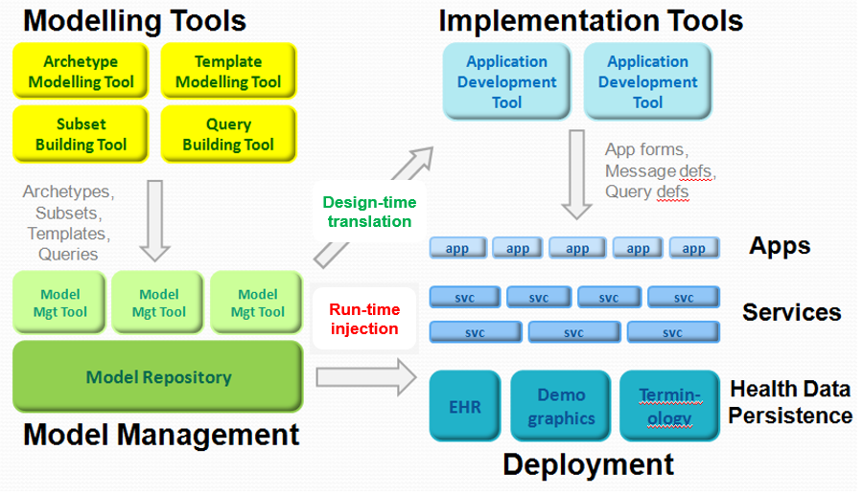
What is openEHR?
openEHR is a clinical knowledge platform, open and independent technology provider.
The platform is specified in a set of standards, implementation specifications and tools that meet the most widespread technical criteria.
Open philosophy implies that the use of definitions and specifications is freely accessible
OpenEHR is NOT a software, a messaging system or an interoperability standard (it complements the existing ones –HL7, FHIR, ...)

Slide 26
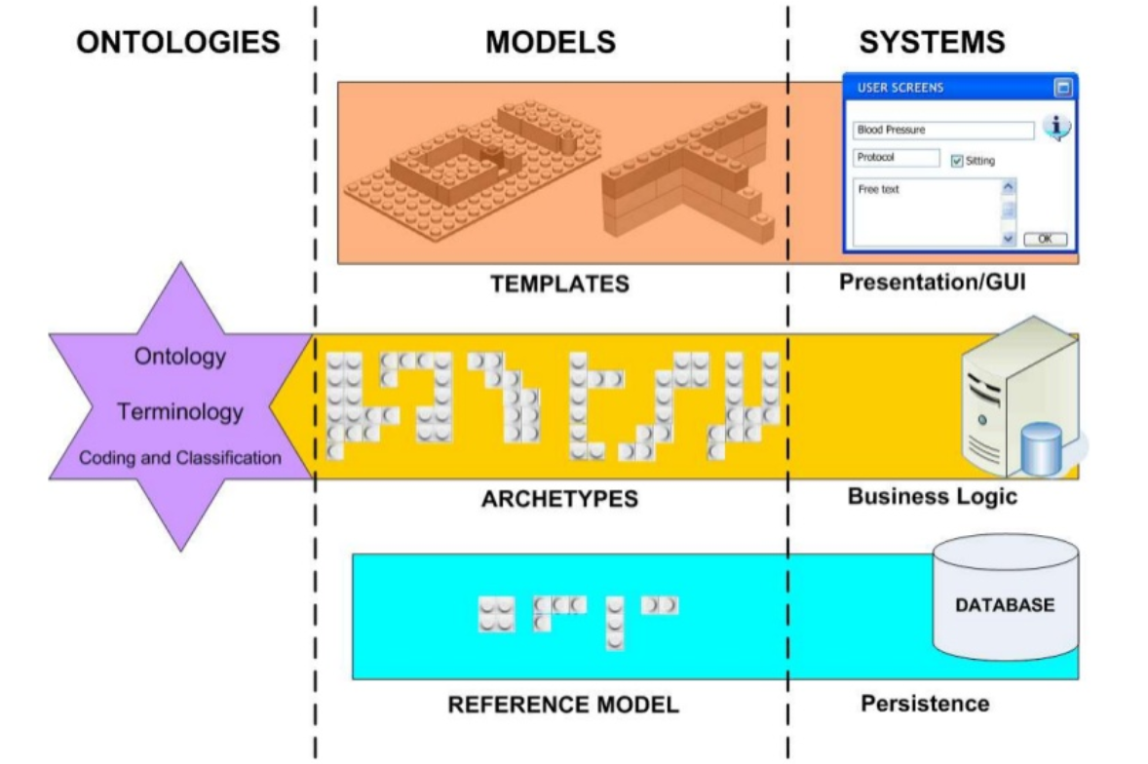
Representing knowledge in openEHR
The core of openEHR is a set of standards, specifications and implementation practices, as well as tools related to the representation of knowledge. Its focus is the formal representation of clinical knowledge, which serves as a guide for software development.
The approach of this representation is a multilevel modelling of the health knowledge domain through formal languages:
Templates: Groups of archetypes that are represented together with an indication of the characteristics of the interface to be developed.
Archetypes: Constructions based on reference models that represent medical concepts in a tree structure.
Reference models: Fundamental data and structures to represent concepts with content restrictions.

Slide 27
Strategic approach
We are establishing the foundations of a full EHR
We are starting in ambulatory care
The standard selection criteria have been:
Strong governance of clinical data models
Strong international community support
Unlocking clinical data models, thus enabling innovation
Persistence of data
Maximum granularity
Includes care pathway support

Slide 28
Our view for an open future
We are building an INFOSTRUCTURE
Business processes
Information needs
Applications
Technology
We will decouple data from applications, storing data in an open format
This will enable data to follow the patient
This will foster better integration and collaboration
It will help scaling-up innovations

Slide 29
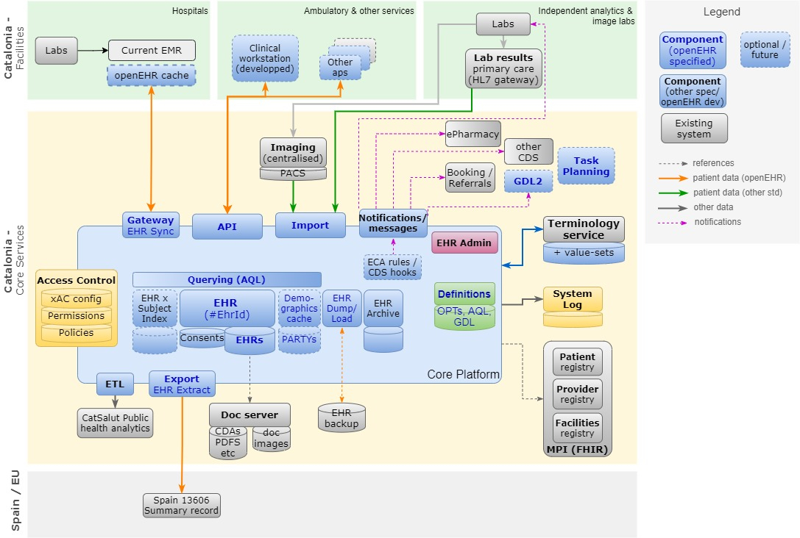
Our approach

Slide 30
Thank you! Dr. Jordi Piera-Jiménez Director of the Digital Health Strategy for Catalonia Catalan Health Service jpiera@catsalut.cat @jpieraj

