Slide 1
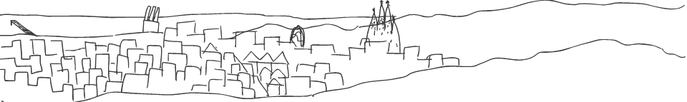

Health Economics Unit
North Metropolitan Territorial Authority
Catalan Health Institute
February 28th 2022

Slide 2



About me
Francesc López Seguí
Health Economist
PhD Biomedicine & M.Sc. Economics
Associate Professor at Pompeu Fabra University /
Center for Research in Health Economics
Member at the Research Group on Innovation, Health Economics and Digital Transformation (INEDIT) at the Germans Trias i Pujol Research Institute

Slide 3
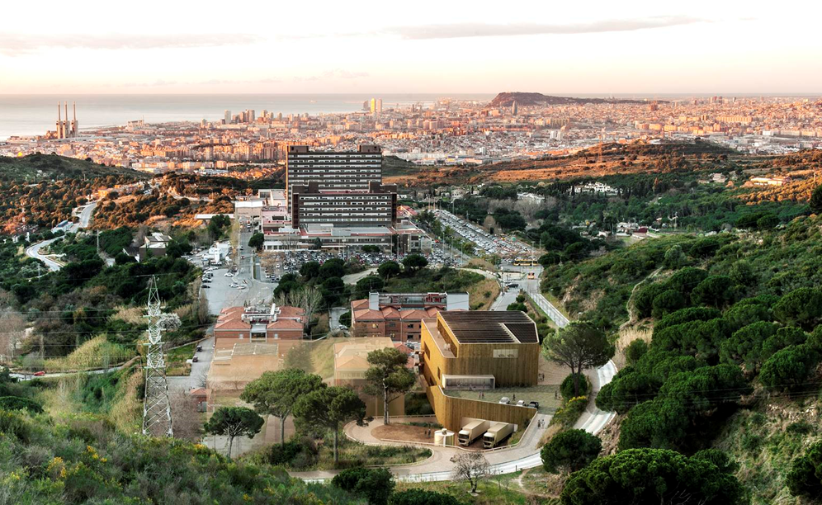
About us
9,194,084 primary care visits
146,352 hospital urgencies
748 articles published
315,008 image tests
€566,933,431 budget
8,104 professionals
1 Health Economist
Source: 2019 NMTA-CHI Annual Report
Notes:
misión : motivo o la razón de la existencia de la empresa
visión: lugar a dónde la empresa debe llegar
valores: creencias y los principios que rigen a una empresa

Slide 4
Health Economics Unit | North Metropolitan Territorial Authority - Catalan Health Institute
Mission To maximize the value of health resources by generating applied and high-quality knowledge based on the empirical evidence of the activity of our region
Vision To consolidate the presence of Health Economics and evidence-based practice at the macro, meso and micro decision-making levels of the region.
Values Critical spirit, responsibility, public sense.

Slide 5
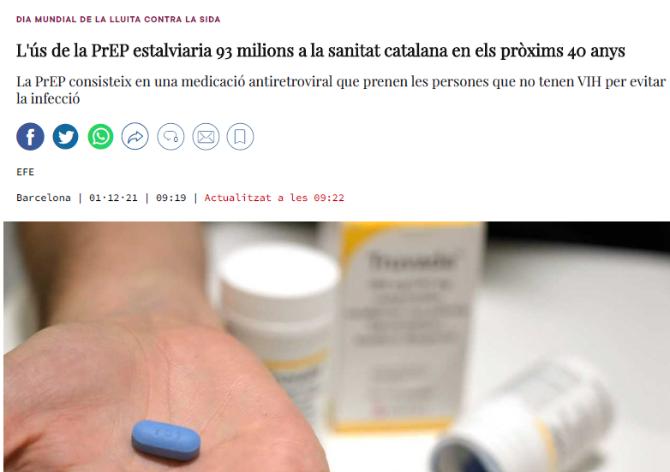
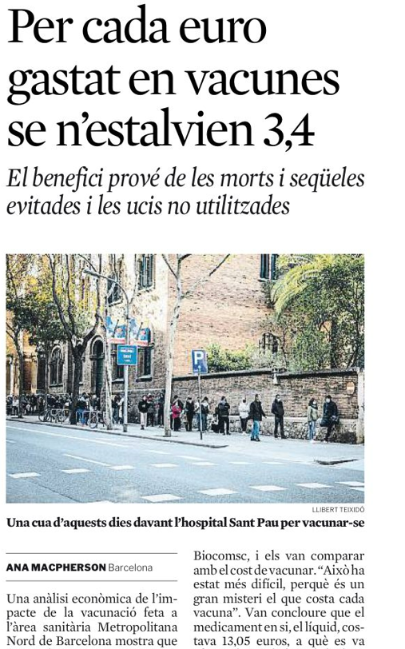
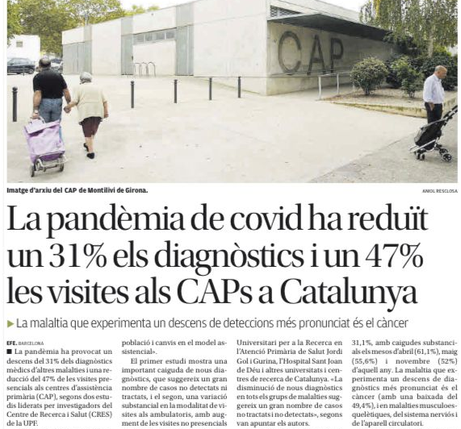
Health Economics Unit | North Metropolitan Territorial Authority - Catalan Health Institute
What we do (2021 in brief)
López Seguí, F.; Estrada Cuxart, O.; Mitjà i Villar, O.; Hernández Guillamet, G.; Prat Gil, N.; Maria Bonet, J.; Isnard Blanchar, M.; Moreno Millan, N.; Blanco, I.; Vilar Capella, M.; Català Sabaté, M.; Aran Solé, A.; Argimon Pallàs, J.M.; Clotet, B.; Ara del Rey, J. A Cost-Benefit Analysis of the COVID-19 Asymptomatic Mass Testing Strategy in the North Metropolitan Area of Barcelona. Int. J. Environ. Res. Public Health 2021, 18, 7028. https://doi.org/10.3390/ijerph18137028
López Seguí, F.; Oyon Lerga, U.; Laguna Marmol, L.; Coll, P.; Andreu, A.; Meulbroek, M.; López Casasnovas, G.; Estrada Cuxart, O.; Ara Rey, J.; Quiñones, C.; Perez, F.; Fernandez, J.; Rivero, A.; Clotet, B. Cost-Effectiveness Analysis of the Daily HIV Pre-Exposure Prophylaxis in Men who Have Sex with Men in Barcelona. Preprints 2021 https://www.preprints.org/manuscript/202111.0295/v1
López Seguí, F.; Navarrete Duran, J.M.; Tuldrà, A.; Sarquella, M.; Revollo, B.; Llibre, J.M.; Ara del Rey, J.; Estrada Cuxart, O.; Paredes Deirós, R.; Hernández Guillamet, G.; Clotet Sala, B.; Vidal Alaball, J.; Such Faro, P. Impact of Mass Workplace COVID-19 Rapid Testing on Health and Healthcare Resource Savings. Int. J. Environ. Res. Public Health 2021, 18, 7129. https://doi.org/10.3390/ijerph18137129
López, F.; Català, M.; Prats, C.; Estrada, O.; Oliva, I.; Prat, N.; Isnard, M.; Vallès, R.; Vilar, M.; Clotet, B.; Argimon, J.M.; Aran, A.; Ara, J. A Cost–Benefit Analysis of COVID-19 Vaccination in Catalonia. Vaccines 2022, 10, 59. https://doi.org/10.3390/vaccines10010059

Slide 6
Health Economics Unit | North Metropolitan Territorial Authority - Catalan Health Institute
Roadmap (2022 expected)
Rapid Diagnostic Unit
Diabetic foot
Ophthalmic Screening
CardioMEMS
Tuberculosis
Venous Access Nursing Teams
HIV Pre-exposure prophylaxis
Birth Center
Complex Chronic Patient
Home ventilation
Lung Cancer Screening
Osteoporosis
Renal denervation
Intermediate Respiratory Care Units
Obstructive Sleep Apnea Syndrome
Hypoachusia
Long COVID
Hospital-At-Home
Schistosomiasis

Slide 7
Health Economics Unit | North Metropolitan Territorial Authority - Catalan Health Institute
With whom
CIO
CEO
CFO
IT
Data Protection Officer
Accounting
IGTP
CInO
Universities
Drug Research Ethical Committee
Innovation and Digital Transformation
Artificial Intelligence
Other Healthcare system’s regions
Strategic projects
Transversal processes
Clinical Documentation
Committee for the Improvement and Adequacy of Care and Clinical Practice
Primary
Care
Communication

Slide 8
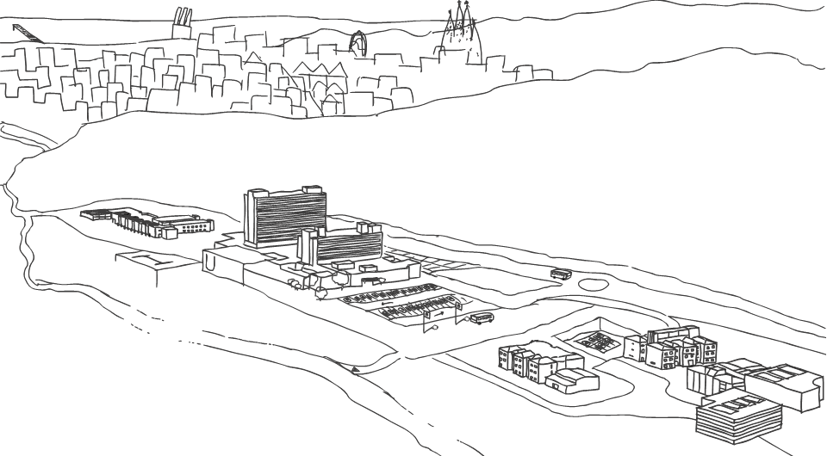

Thank you
flopezse.germanstrias@gencat.cat
francesc lopez segui

