Slide 1


Laboratori Clínic de la Metropolitana Nord (LCMN)
April 2022
Ignacio Blanco, MD PhD
Clinical Director LCMN
Chairman, Genetics Department

Slide 2
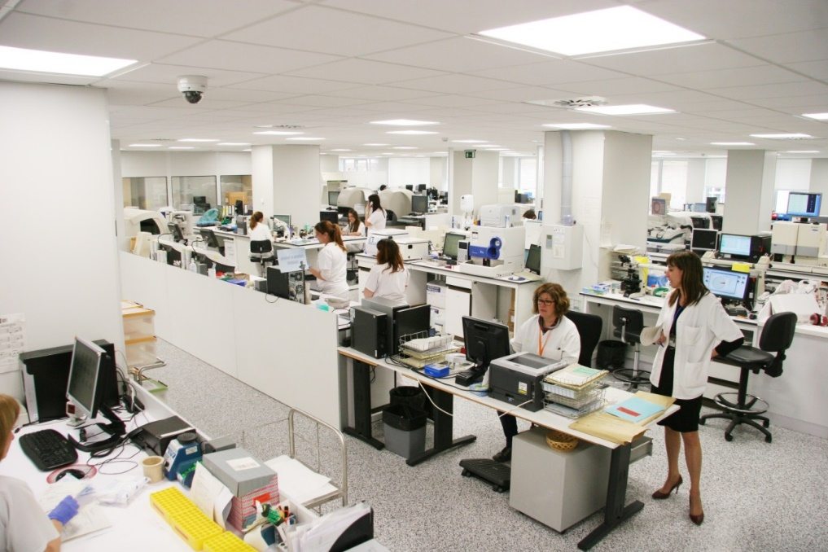


2016
Laboratori Clínic

Slide 3

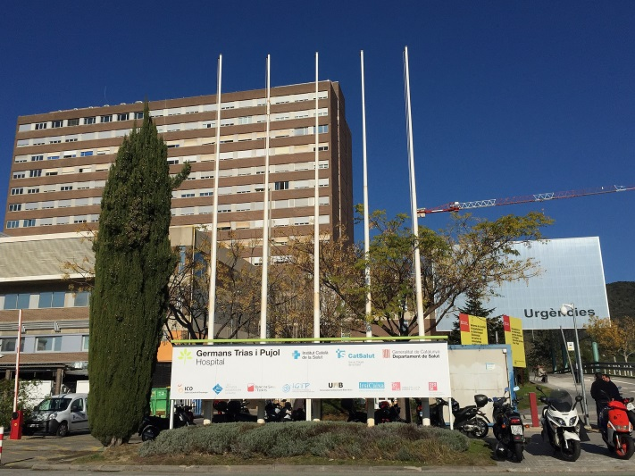
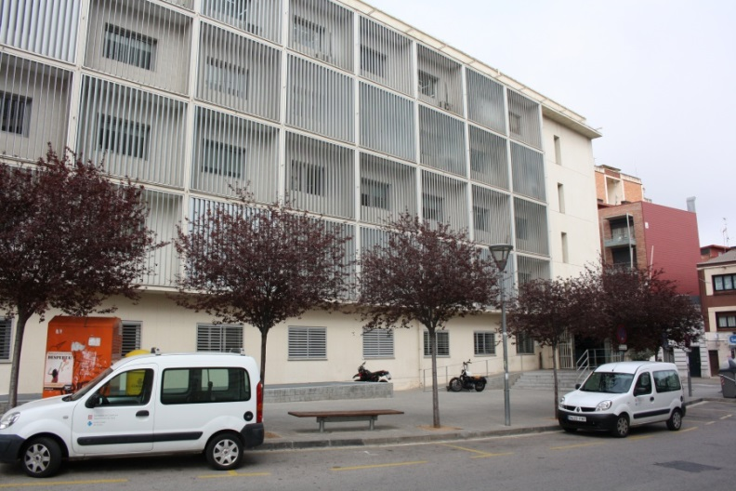


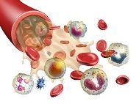

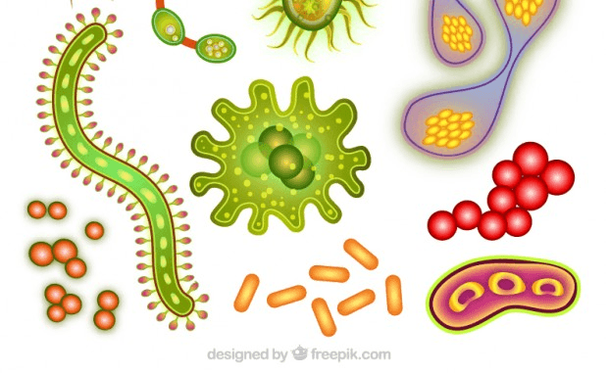
Tertiary Care Laboratory
Primary Care Laboratory
LCMN
Laboratoris HGTiP
Laboratori Dr. Robert
Clinical Analysis and Biochemistry
Immunology
Hematology
Genetics
Microbiology

Slide 4
Mission
The mission of the LCMN is to offer clinicians and citizens an integral and high quality service, in all areas of laboratory medicine, and carry out pioneering research and teaching activities, aimed at improving clinical practice.
Laboratori Clínic

Slide 5
Vision
Being a reference organization in Catalonia in the clinical laboratory medicine and a leader in the comprehensive analytical diagnosis, in research and teaching, with the commitment of its professionals and the recognition of society.
Laboratori Clínic

Slide 6
Values
Excellence
Proximity
Respect
Commitment
Professional recognition
Laboratori Clínic

Slide 7
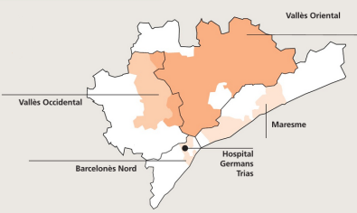

Facts and Figures
We provide assistance to nearly 1.5 million inhabitants (20% of the total population of Catalonia).
We manage the samples from the Germans Trias i Pujol University Hospital and more than 110 primary care centers in the area
Clinical Director 1
Chairman of Department 5
Physicians 38
Chief of Nursing 1
Tech Coordinator 2
Residents 11
Technicians 150
Administrative staff 14
222 Professionals

Slide 8



Quality certifications and accreditations
Laboratori Clínic
External Quality Assessment (EQA)
Genetic Couselling Service
  Monogenic Disorders pilot EQA
  Oncogenetics pilot EQA
  Dysmorphology pilot EQA
  Cardiogenetics pilot EQA

Slide 9


Facts and Figures
Clinical Activity 2021
Determinations 11.150.159
Requests 2.102.330
URV’s 286.991.252
Complexity 25.74
35.738 Determinations / day
6.738 Requests/ day
16.845 Samples / day

Slide 10
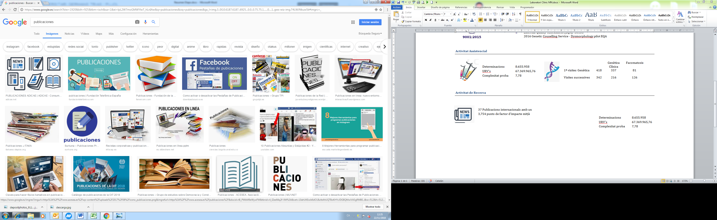
Facts and Figures
Clinical Activity 2021
Determinations 11.150.159
Requests 2.102.330
URV’s 286.991252
Complexity 25,74
Collaboration to develop or update 20 Clinical Protocols for improvement in clinical practice

Slide 11
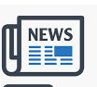
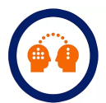



Facts and Figures
2021
Research Activity
Teaching / Training activity
104 International publications
  Q1:61
  IF: 630.15
  IF mean: 6.12
340 Sessions carried out in the different Clinical Departments
10 National publications
  IF: 16.,9
  IF mean: 1.68
177 Continuing Education Activities
1 Professor
2 Senior Lecturer
8 Lecturers
11 Assistant lecturers
29 Competitive projects active and granted in 2021
UAB, Tecnocampus-UPF

Slide 12



Clinical Analysis and Biochemistry
Hematology
Immunology
Microbiology
Genetics

Slide 13

Clinical Analysis and Biochemistry
Hematology
Immunology
Microbiology
Genetics

Slide 14
1.66 Million samples

Slide 15
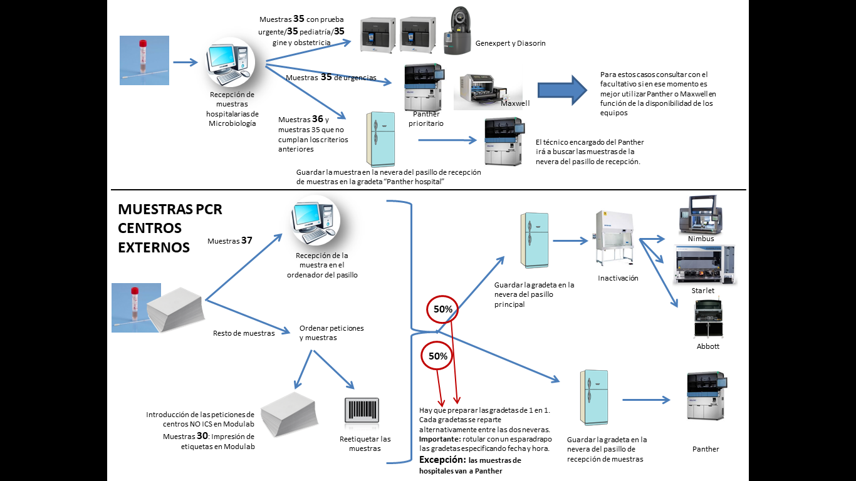

Slide 16
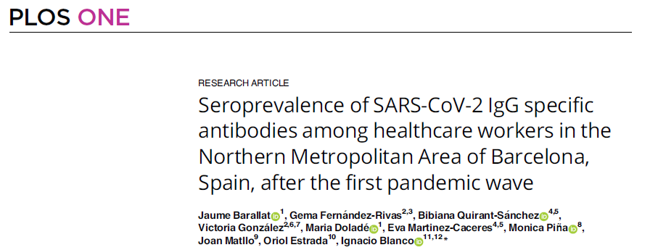
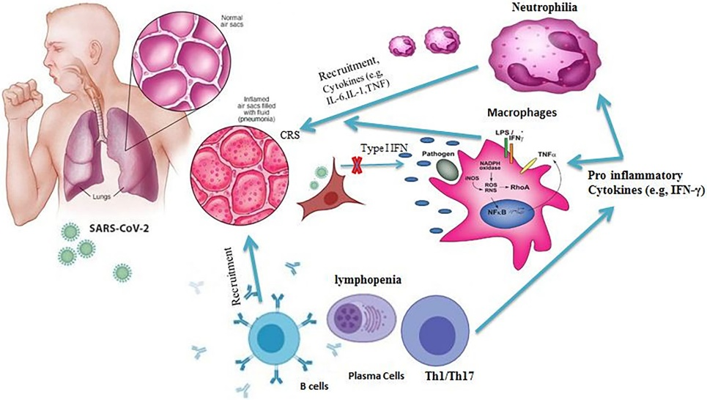

Slide 17
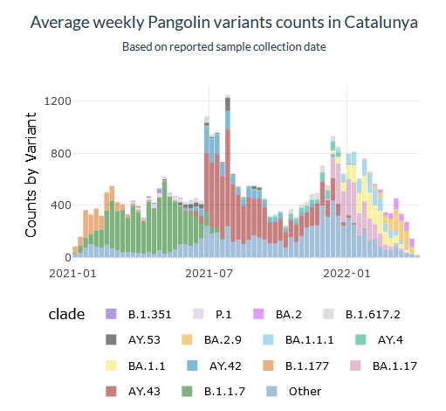
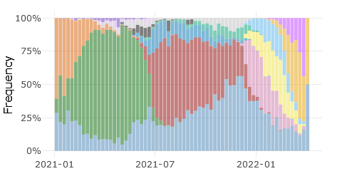




HUB Seqüenciació Campus Can Ruti
http://covidtag.paseq.org/

Slide 18
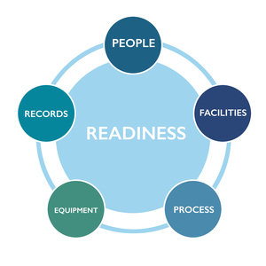

Slide 19

https://www.channelfutures.com/reports-digital-issues/manufacturing-sd-wan-the-challenges-the-opportunities

Slide 20


Thanks
iblanco.germanstrias@gencat.cat
gencat.cat/ics

