Slide 1


Therapeutic Plan: A tool for clinical support decision

Slide 2
NEUROREHABILITATION
CLINICAL INTERVENTION
ASSESSMENT
OBJECTIVES
ASSESSMENT
AMI
ECB
MEDICAL REPORTS
SCALES
TESTS
JOINT MEETING
EDUCATION
MEDICAL ANNOTATIONS
AGENDA
NURSE INTERVENTIONS
MEDICAL TASKS
...
MEDICAL REPORTS
SCALES
TESTS
INFORMATION SILOS
INSTITUT GUTTMANN

Slide 3
NEUROREHABILITATION
CLINICAL INTERVENTION
ASSESSMENT
OBJECTIVES
ASSESSMENT
THERAPEUTIC PLAN

Slide 4
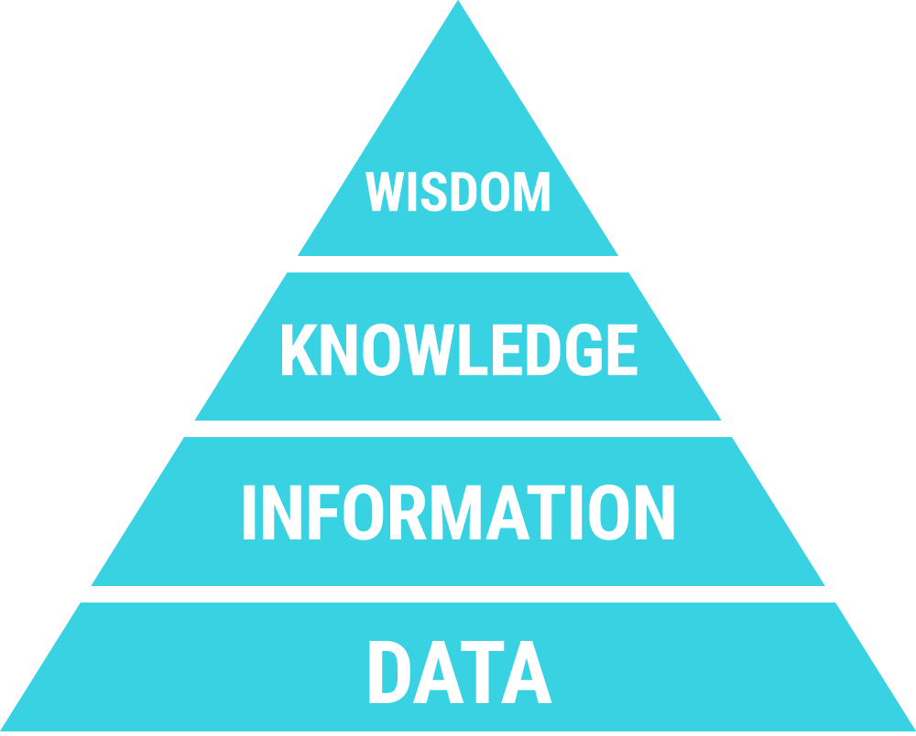
THERAPEUTIC PLAN – MAIN GOALS
To gather all the information in one specific program
To design AI tools that allows clinicians to:
  Given a single patient:
    To better understand what happened
    To better understand why happened
    To predict patient’s progress
    To support clinical decisions to plan the best therapy based on existing data

Slide 5
NEUROREHABILITATION – How?
CLINICAL INTERVENTION
ASSESSMENT
OBJECTIVES
ASSESSMENT
THERAPEUTIC PLAN
INSTITUT GUTTMANN

Slide 6
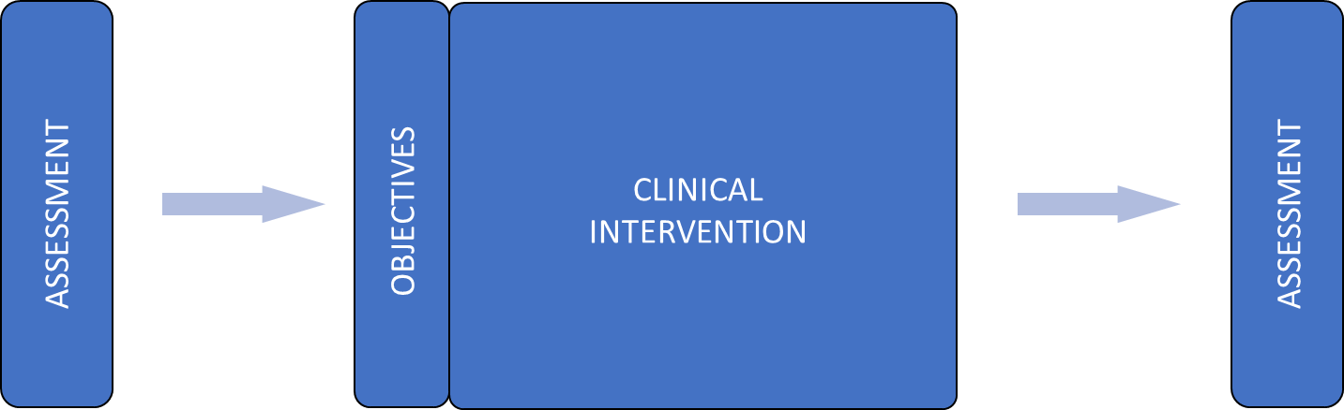
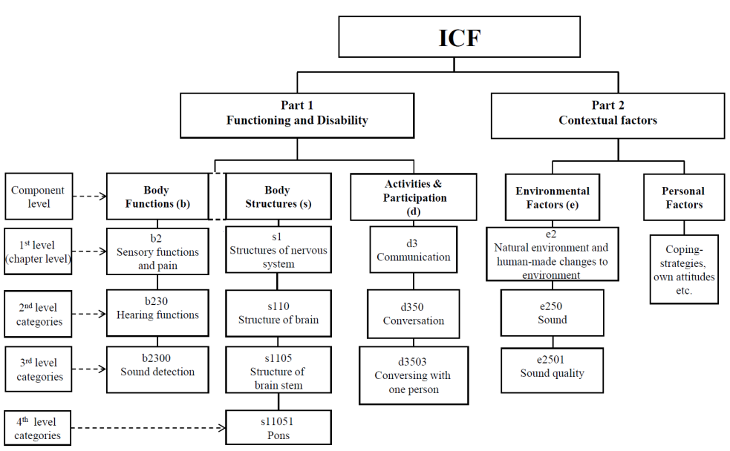

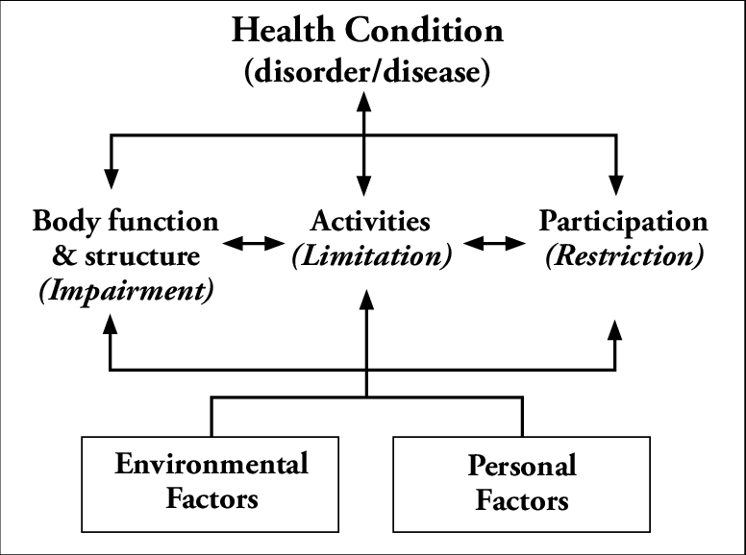

THERAPEUTIC PLAN - ASSESSMENTS
Too many assessment measures (scales and questionnaires) depending on pathology (SCI, TBI, Stroke…).
  Difficulty to compare patients
  Overlapping measures
  Poor benchmarking
Use standard language to describe patients
  International Classification of Functioning, Disability and Health (ICF)
  http://www.who.int/classifications/icf/en/

Slide 7
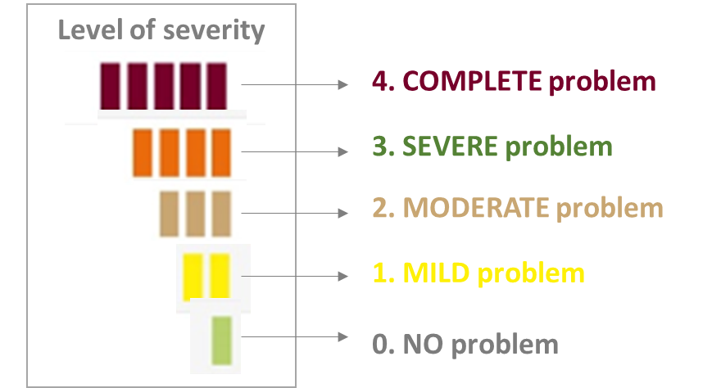
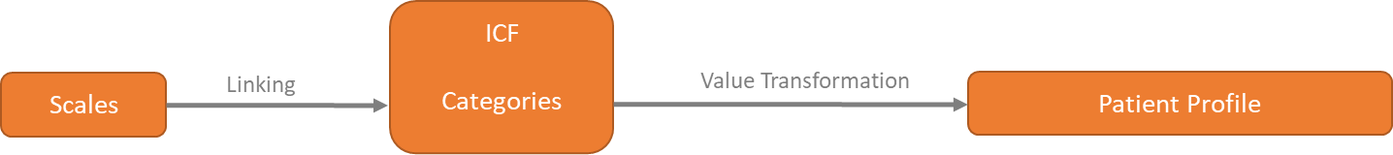
THERAPEUTIC PLAN - HIERARCHY
DOMAIN
BODY FUNCTION
Therapeutic plan
  Structure
1
n
FUNCTION
Mental functions
1
n
Problem assessment
CATEGORY
MEMORY
  Qualifiers
Automatic transformation

Slide 8
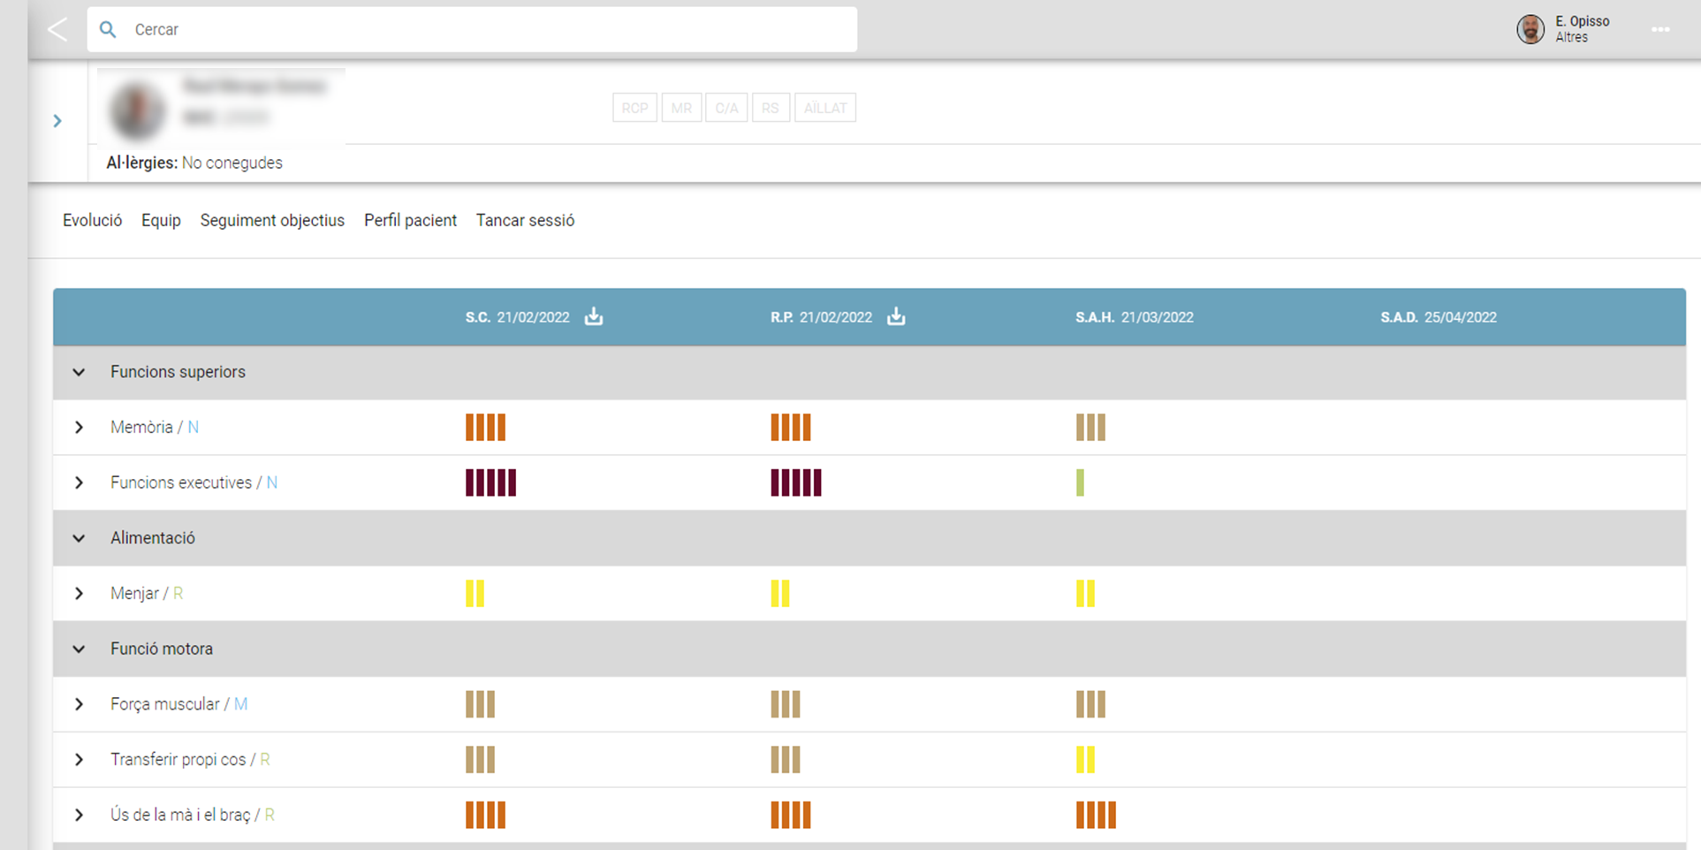

Slide 9

NEUROREHABILITATION
O₁
O₂
O₃
O₄
O₅
O₆
.
.
O_{N}
I₁
I₁
I₁
b110b112...
d230d330d450
d452
...
e200
e210
e570
...
b110b112...
d230d330d450
d452
...
e200
e210
e570
...
I₂
I₃
I₅
I₄
CLINICAL INTERVENTION
ASSESSMENT
OBJECTIVES
I₆
ASSESSMENT
I₇
I₈
I_{N}
THERAPEUTIC PLAN

Slide 10
THERAPEUTIC PLAN - HIERARCHY
DOMAIN
BODY FUNCTION
Therapeutic plan
  Structure
1
n
FUNCTION
Mental functions
1
n
Problem assessment
CATEGORY
MEMORY
1
n
To recall information to follow basic activities with the help of a third person
Goal to achieve
OBJECTIVE
m
n
Set of therapeutic interventions to achieve the goal
Intervention 1
Intervention 2
Intervention n
INTERVENTION

Slide 11

THERAPEUTIC PLAN – OBJECTIVES & INTERVENTIONS

Slide 12
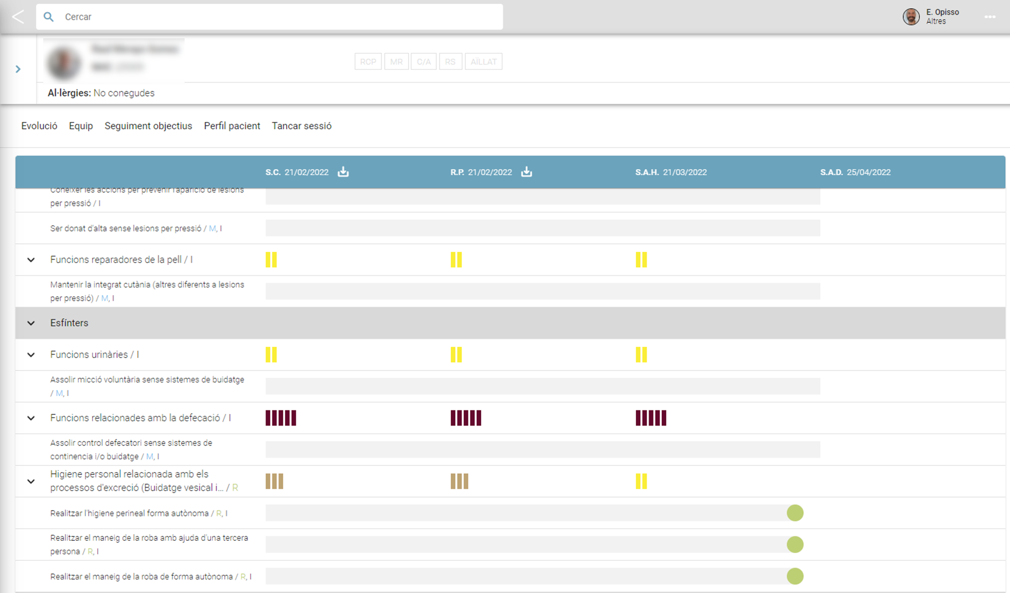

Slide 13
THERAPEUTIC PLAN – so far….
September’21. First production version in all hospitalization units.
473 therapeutic plans
  145 strokes
  99 spinal injuries
  69 traumatic brain injuries
  60 other non-traumatic brain injuries (tumors, anoxia,…)
  100 other (PCI, MS,…)
142 women
Mean age 45±19 years old

Slide 14
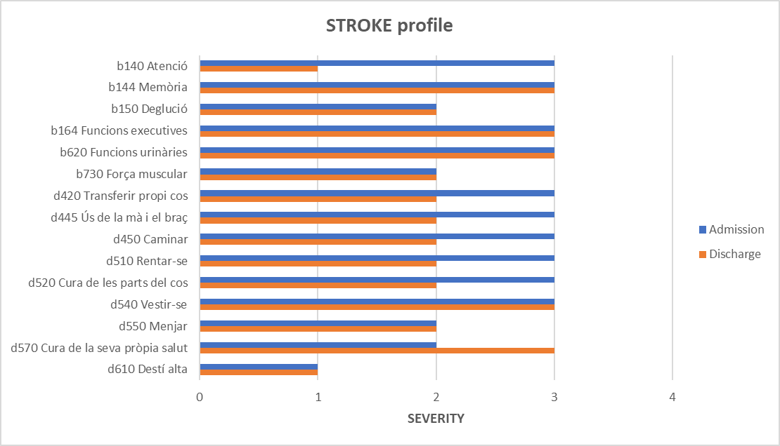
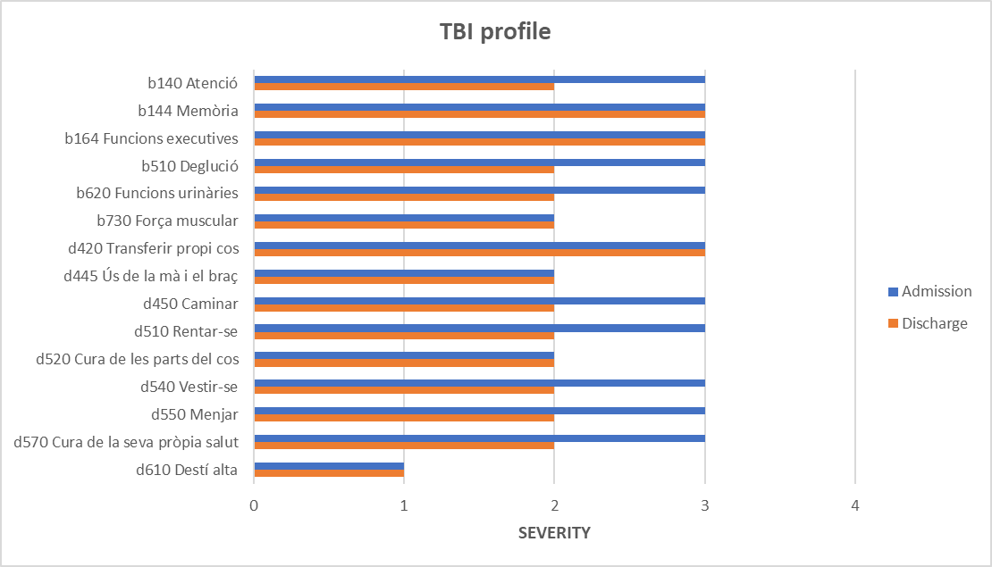
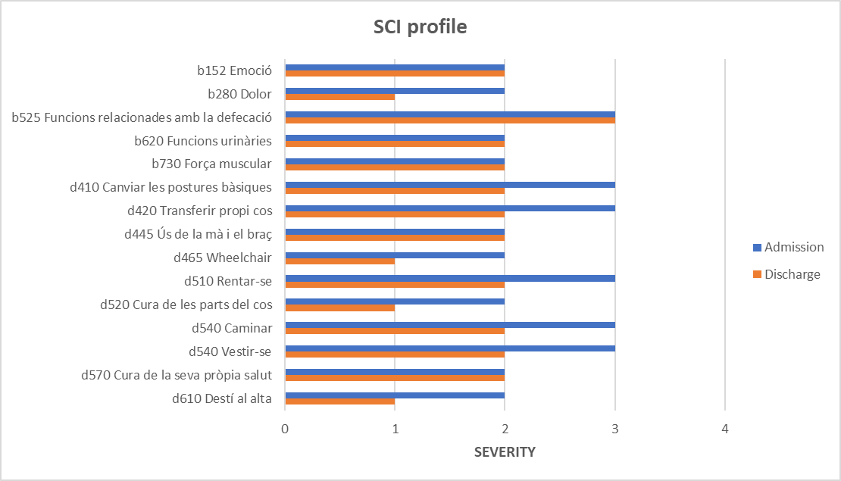
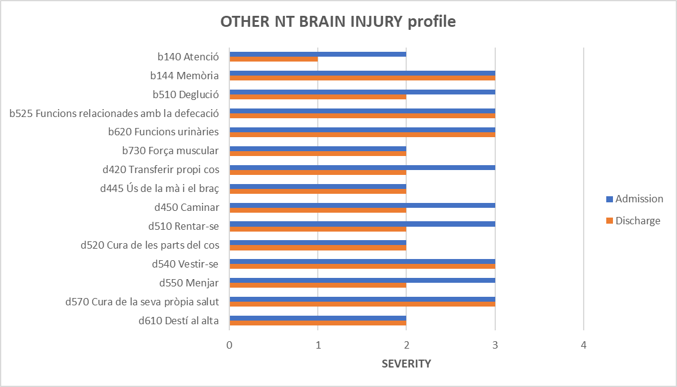
THERAPEUTIC PLAN – PROFILES

Slide 15
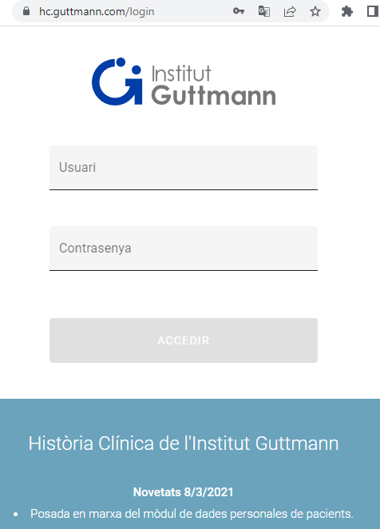

THERAPEUTIC PLAN – WRAP-UP
The therapeutic plan must be the place where we gather all the information of the patient journey
The therapeutic plan should be used to identify different patient profiles (based on pathologies or not) but with the aim to optimize resources devoted to their treatment
The therapeutic plan must be the breeding ground from where to develop AI algorithms to:
  Be used to identify non-explicit relationships in the clinical data
  Generate predictions of the patients’ progress
  Support clinical professionals in the design of evidence-based personalized treatments

Slide 16


Eloy Opisso
eopisso@guttmann.com

