Slide 1
Take part of the change
A social research project promoted by the Institut Guttmann with the collaboration of the associations of individuals with disabilities of the Social Council

Slide 2
PROJECT

Slide 3
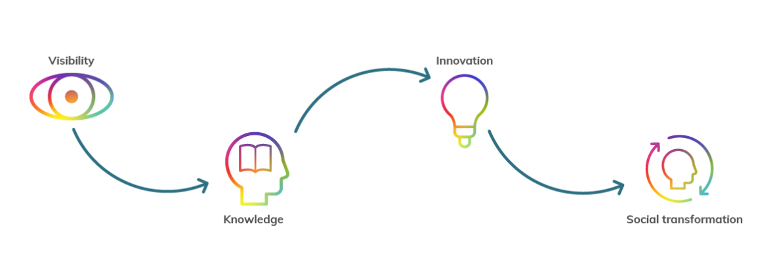
PRESENTAtion
PARTICIPA is a social research project aimed at finding out and understanding how the participation in society of people with disabilities can be guaranteed and promoted, with the intention of transforming it so that it is fully inclusive.

Slide 4
OBJEcTIVe
The research aims to answer the question:
Which are the facilitators and barriers to participation for people with disabilities?
Notes:
Evaluate, codify and rate the participation of people with disabilities and identify determinants of participation (barriers and facilitators).
Analyze the influence of the determining factors on the participation of people with disabilities.
Understand the interactions between the factors that influence participation.
Design innovative interventions and resources to reduce restrictions and promoting factors that facilitate participation.

Slide 5
OBJEcTIVe
To identify the barriers and facilitators that determine the participation in the society of people with disabilities. Initially 6 dimensions will be analyzed:

Slide 6
Who can participate?
Any adult (≥18 years old) who has a disability and resides in Spain or Andorra.
Support assistant personnel involved in the project on behalf of a person with a disability.

Slide 7
methods
Design: Longitudinal Cohort Study (3 years long).
Sample: Cohort of at least 1,000 participants.
Quantitative research methods: 12-15 annual online questionnaires (approximately 10 minutes time per questionnaire).
Qualitative research: a discussion forum advised by professionals (thematic analysis).
Other qualitative research techniques: focus groups, in-depth interviews, analysis and interpretation of working groups, ...

Slide 8
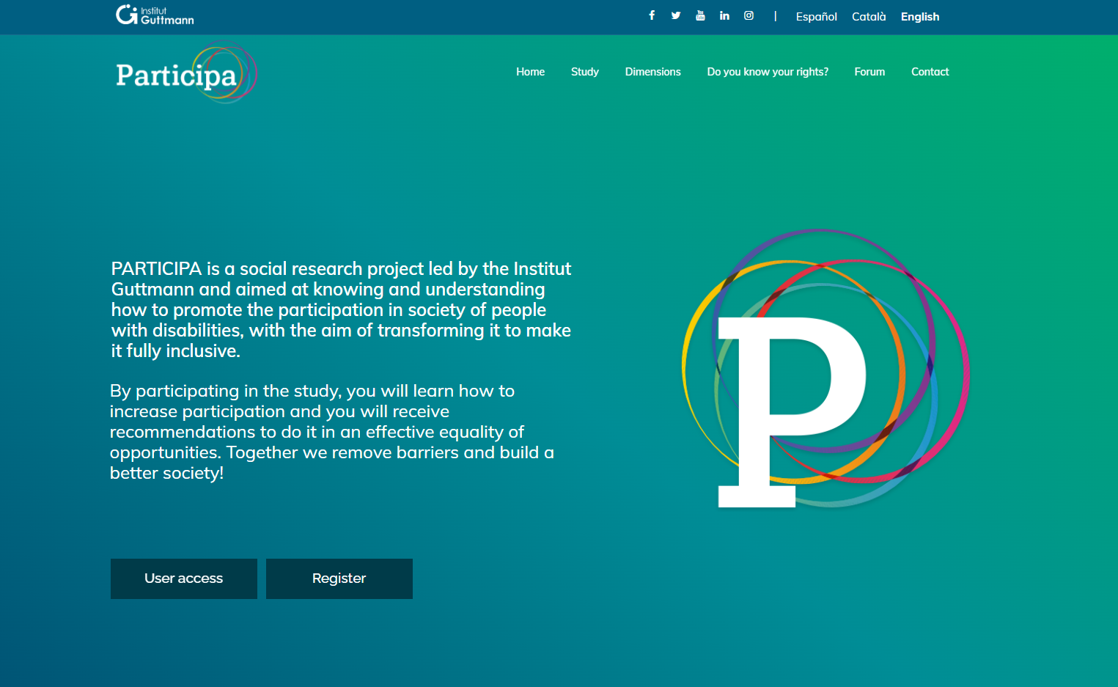
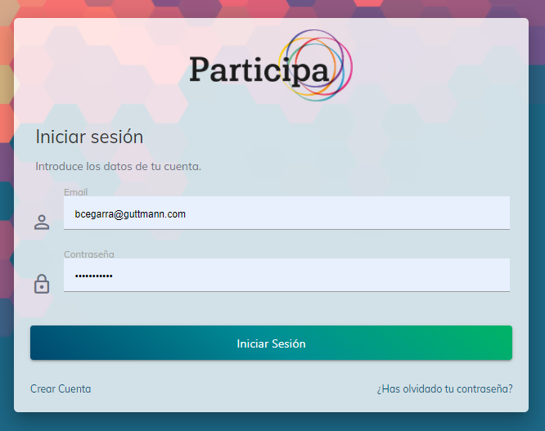
Web
participa.guttmann.com

Slide 9
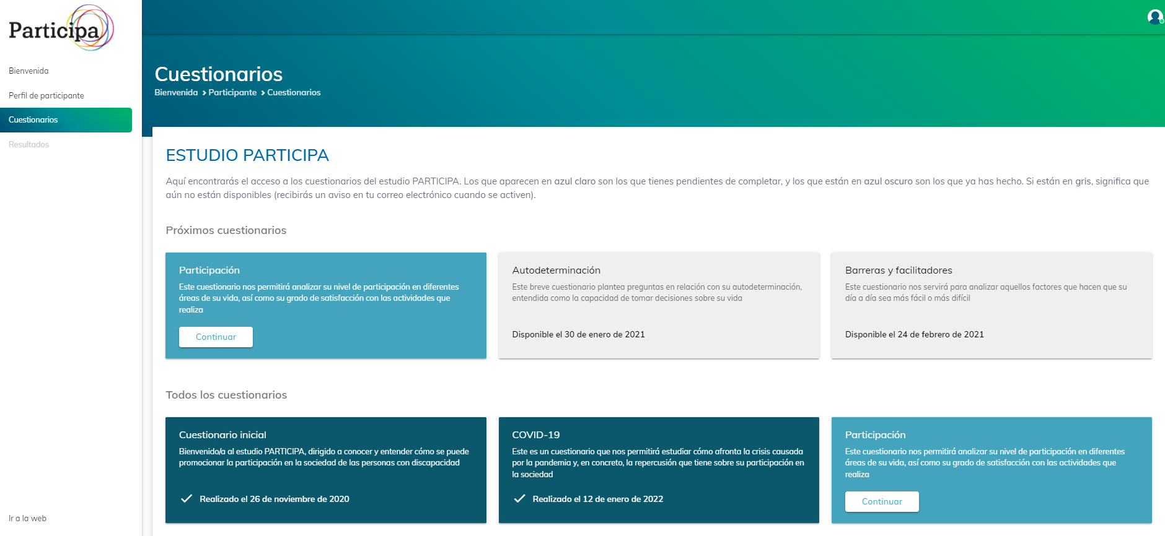

Slide 11
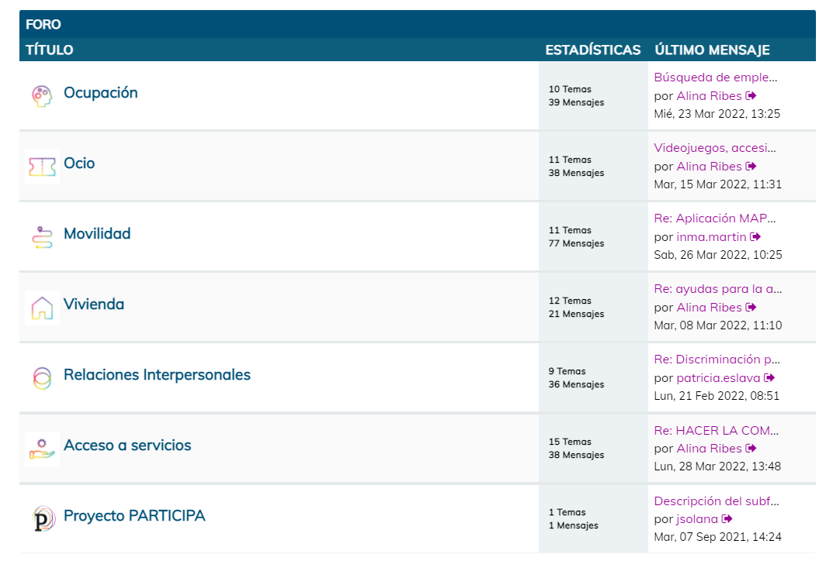

Slide 12
PRELIMINARY RESULTS
PARTICIPA - Login (guttmann.com)

Slide 13
Next steps
Analysis of the data
Increase and maintain the cohort of the study
Report findings and publications
Finding European partners to expand the project abroad

Slide 14
participa.guttmann.com
jsauri@guttmann.com

