Slide 1
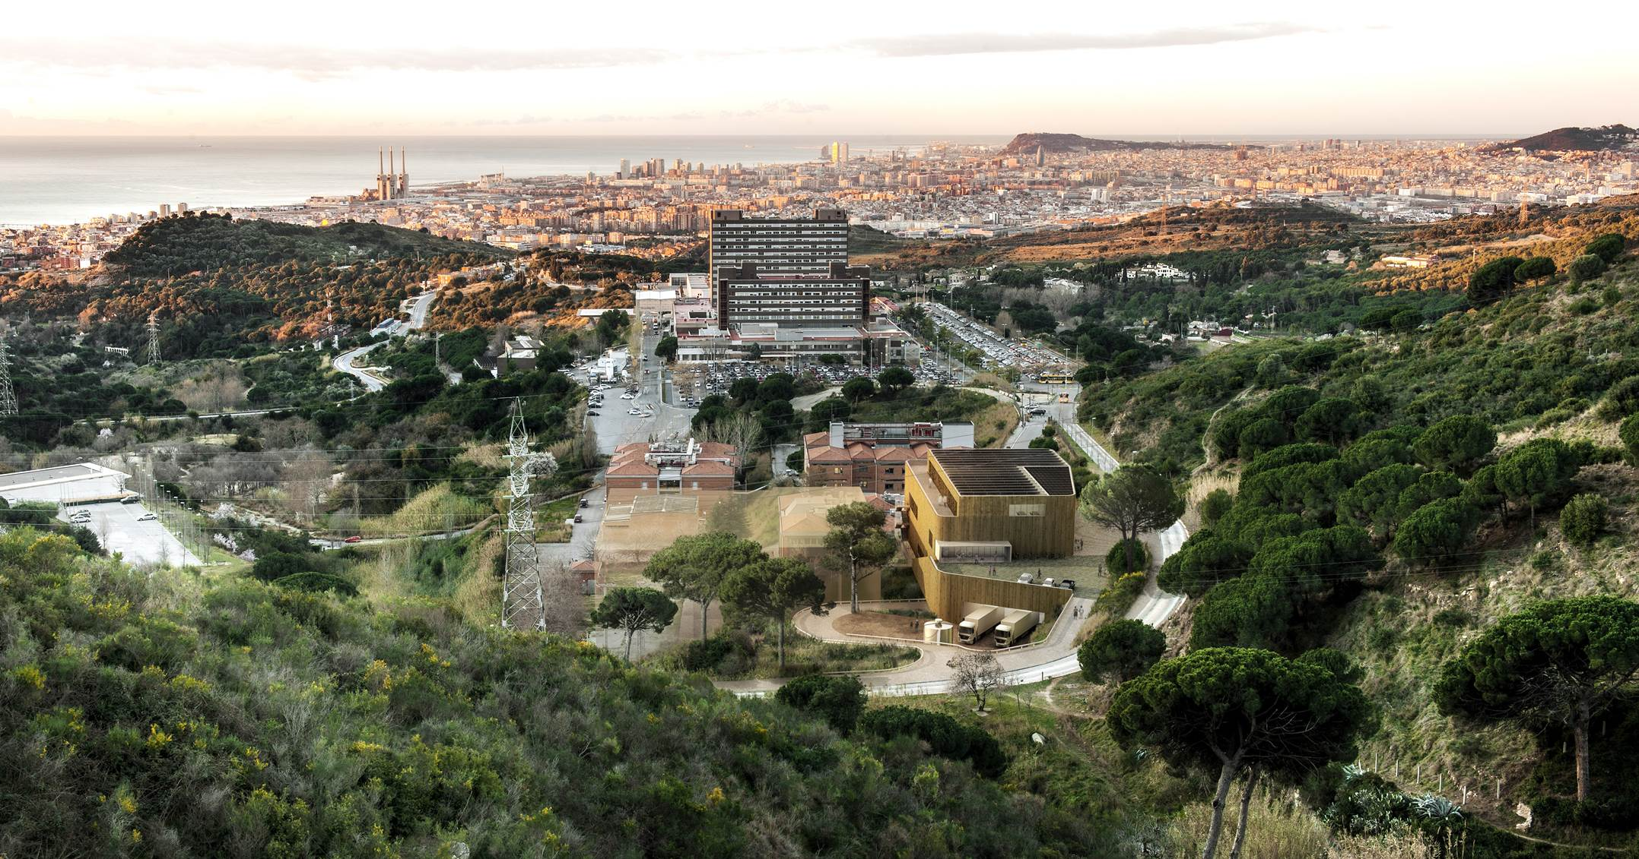
ehealth
DIGITAL TRANSFORMATION
Meritxell Davins Riu
eHealth and Digital Transformation Director

Slide 2
What exactly
is digital transformation?

Slide 3
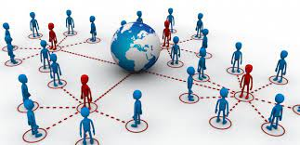
A change to contribute Value
Digital Transformation is not technology
Notes:
La transformación digital és l’aplicació de capacitats digitals a processos, productes i actius per millorar l’eficiència, millorar el valor pel client, gestionar el risc i descubrir noves oportunitat per generar ingresos.

Slide 4
Digital Transformations projects
Value
Need
Actions
Objective
Technology

Slide 5
TELEMEDICINe

Slide 6
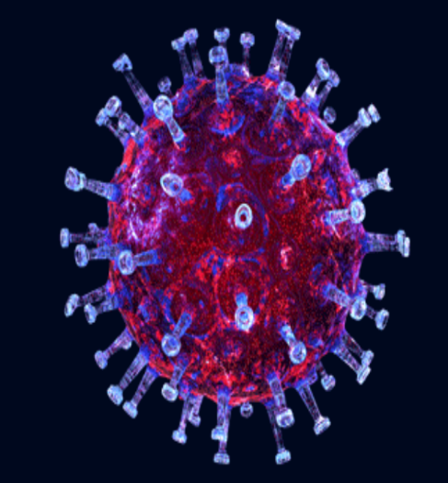
PPORTUNITY

Slide 7
Oncology Society Poll
Before COVID pandemic
After COVID pandemic
Resultados cedidos por Carmen Beato

Slide 8
Telemedicine 2.0

Slide 9
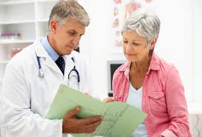
PATERNALISTIC Model
PARTICIPATORY Model

Slide 11
Characteristics eSalut 360
It is an app
360 degrees :
No diferent levels (primary, hospital) fully integrated
No diferents specialist as a independent follow up
The patient feels we are a real team that we want to help him empower himself and improve his selfcare.
Change the model: Patient centered
Personalized
Notes:
Aquest projecte ens permetrà un canvi de model assistencial centrat en el pacient. Passar d’un model més paternalista a un model més participatiu. Integrat en el diferents dispositius assistencial. I integrada en els nostres sistemes d’informació (SAP i eCAP)

Slide 12
Objectives
Strengthen security
Improve Health results
Increase the effficiency and sustainibility of our Healthcare System.
Improve the satisfaction of patients, caregivers and professionals

Slide 13
3 pillars
Monitoring
Clinic variables
Questionnaires
Empowerment
Patient, caregivers
Communication
Notification
Videos, game, pdfs,...
Notes:
El projecte té 3 pilars: Telemonitorització:

Slide 14
The project
Objective
Preventive and anticipatory Medicine
Triage of the visits
Telemonitoring
Active and informed Patient therapeutic adherence
Personalization
Empowerment
Communication
Humanization
Satisfaction
Efficiency of the Healthcare System Security
Health Results

Slide 15
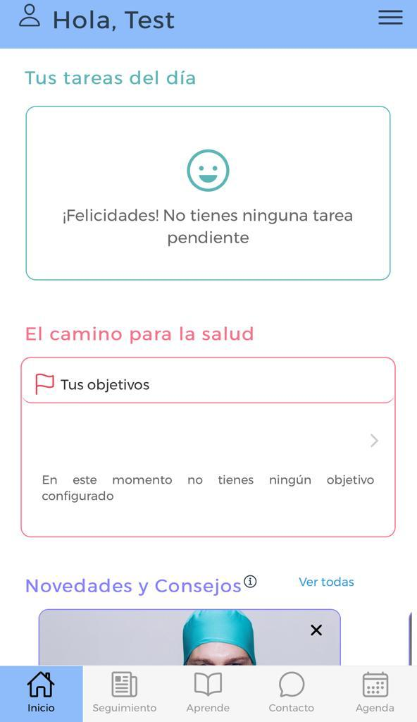
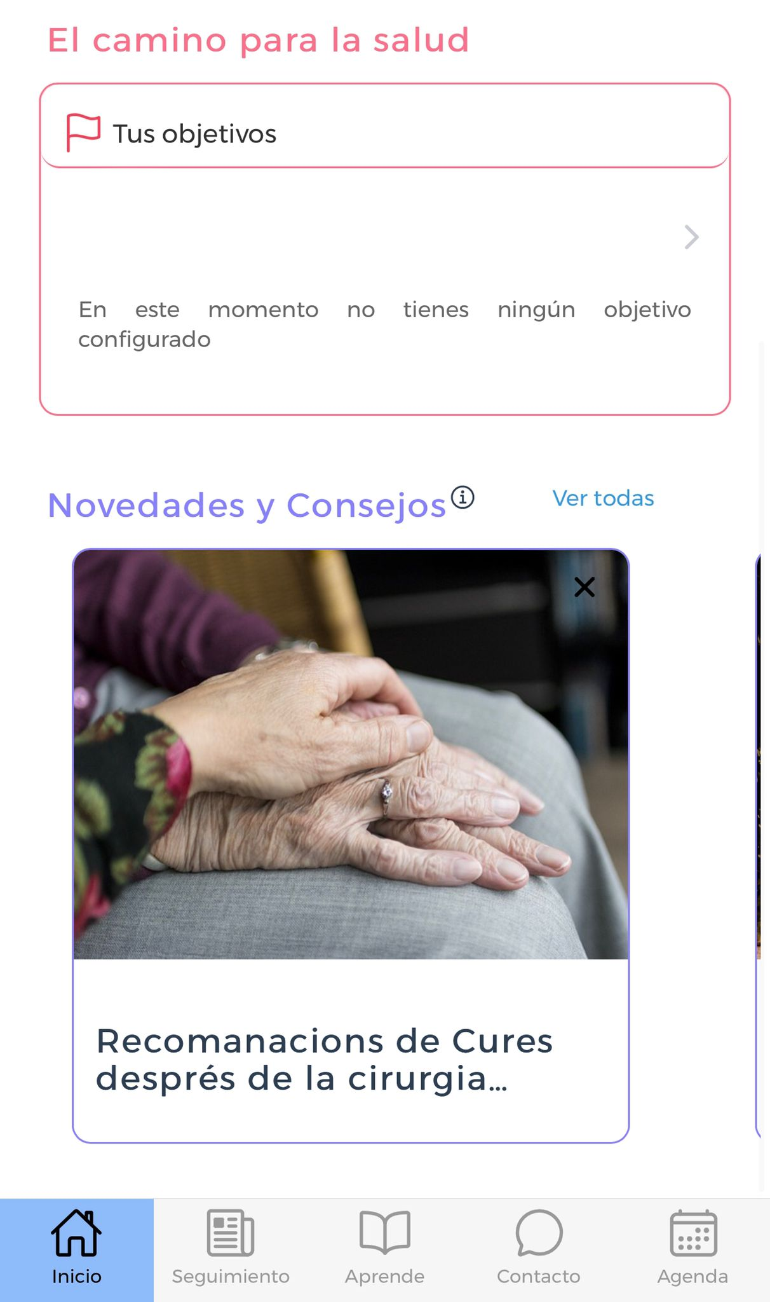

Slide 16
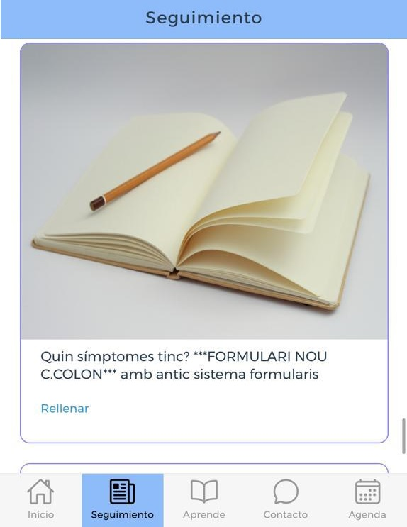
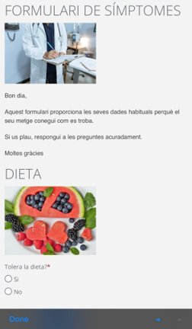
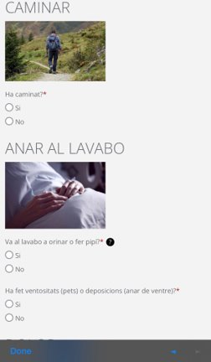

Slide 17
