Slide 1

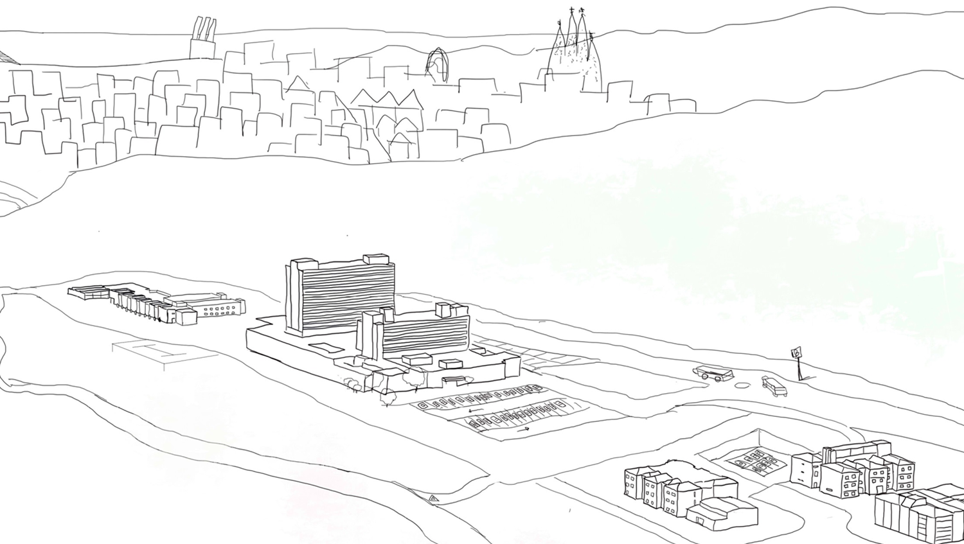

Campus Can Ruti- Badalona
Welcome and outline of the day
Oriol Estrada
Director of Health Strategy and Innovation

Slide 2
Today’s schedule
Contents of
the visit
Block | Time | Lenght (min) | Session | Speaker / Moderator
 | 8.45 | 15 | Arrival and coffee
HGTP | 9.00 | 10 | Welcome and introduction to campus Can Ruti | O Estrada
 | 9.10 | 35 | Understanding Germans Trias: key areas and transformation model: Speakers: R Paredes, A Bayés, I Blanco | O Estrada (moderates)
Innovation & Transformation | 9.45 | 10 | Reshaping healthcare: a transformative innovation model | D Moreno
 |  | 35 | Disrupting the model from the inside R Escrich, F López, T Davins | D Moreno (moderates)
 | 10:30 | 30 | Coffee break and networking
IGTP Research & Innovation | 11:00 | 30 | IGTP: a leading research institute in Catalonia (J Barretina) | J Barretina
 | 11:30 | 20 | Meeting CMCiB | S Capdevila
 | 11:50 | 15 | Toilet break
Institut Guttmann | 12:05 | 05 | Introduction to Institut Guttmann | M Bernabeu
 |  | 40 | Innovation & Research Institut Guttmann: Speakers: H Kumru, E Opisso, J Sauri | M Bernabeu (moderates)
Closure | 12:55 | 05 | Debriefing and closure | O Estrada
 | 13:00 |  | Departure

Slide 3
Introducing the
Campus Can Ruti- Badalona
Oriol Estrada
Director of Health Strategy and Innovation

Slide 4
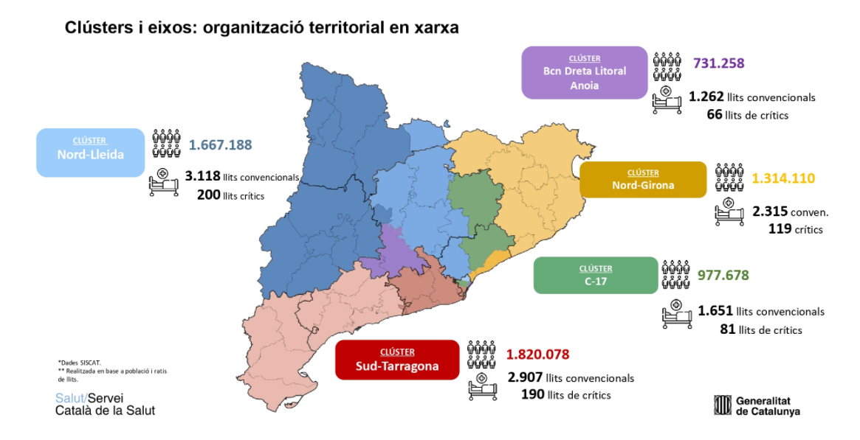
Where is located our Campus?
GT MN-ICS
Can Ruti Campus

Slide 5
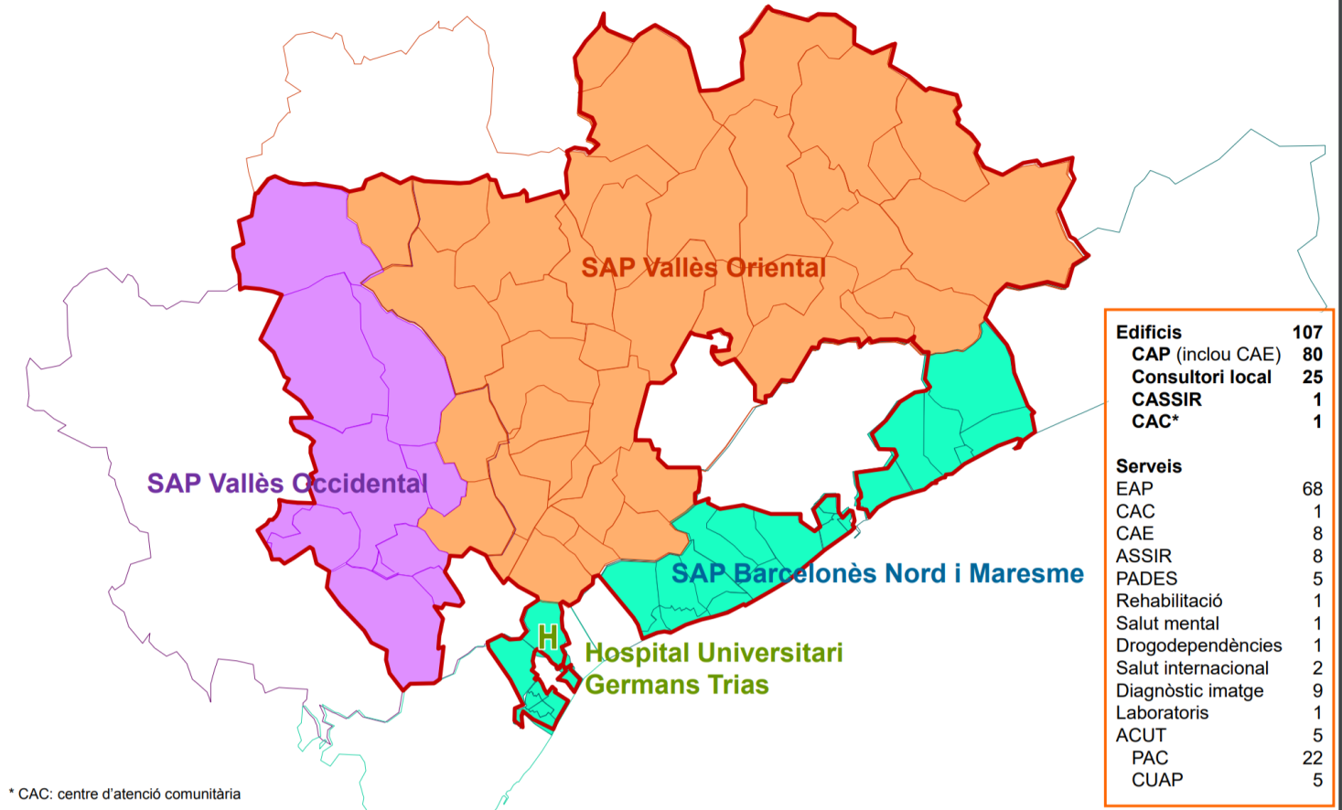

Northern Metropolitan Area Catalan Institute of Health; 2021
Health Services for 1,500,000 people
Can Ruti Campus
Can Ruti campus

Slide 6
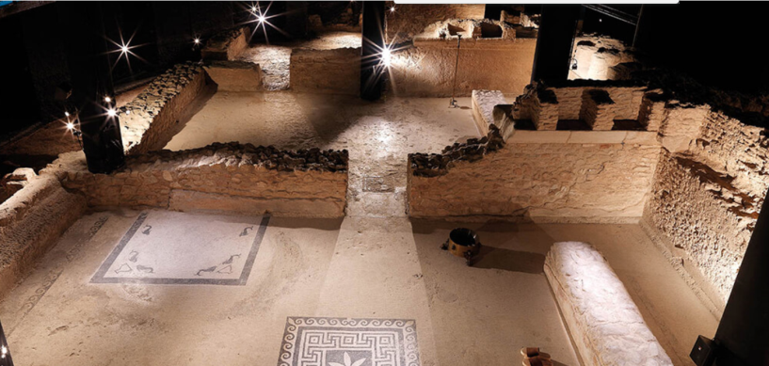
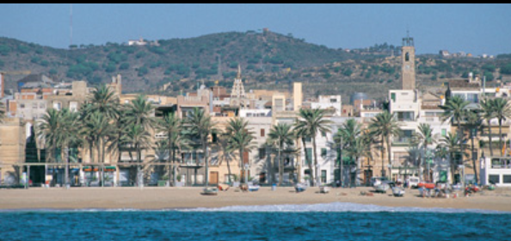
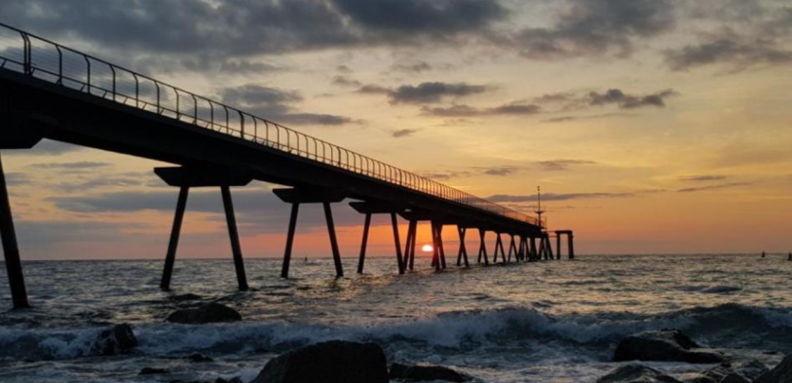
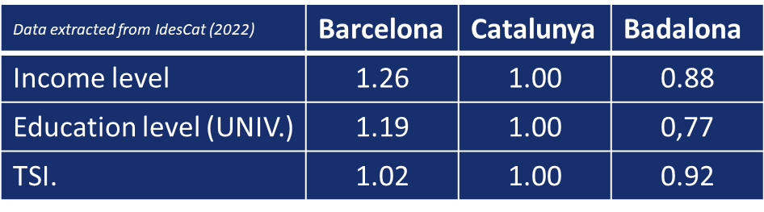
Badalona: a city near Barcelona
From the Iberians and the Romans to the present day:
5000 years of human activity
Can Ruti Campus
Total population: 223,006
Density: 10,303.01 hab/km²

Slide 7
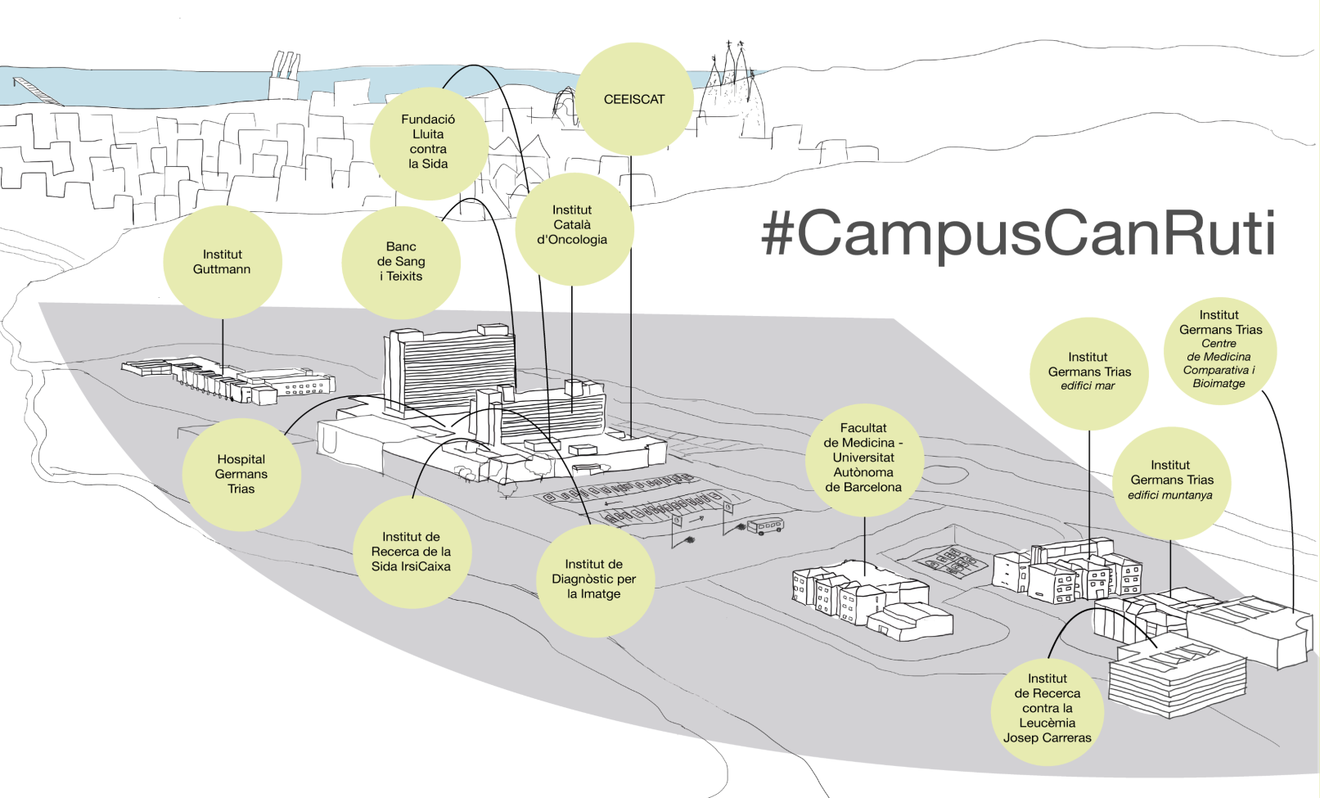
The Can Ruti Campus:
Can Ruti Campus

Slide 8
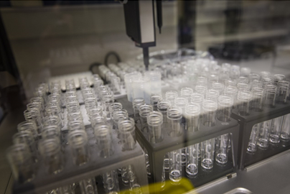
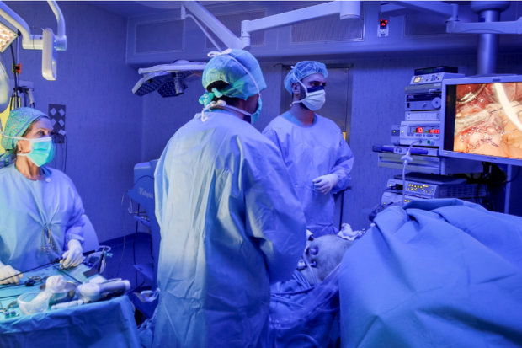
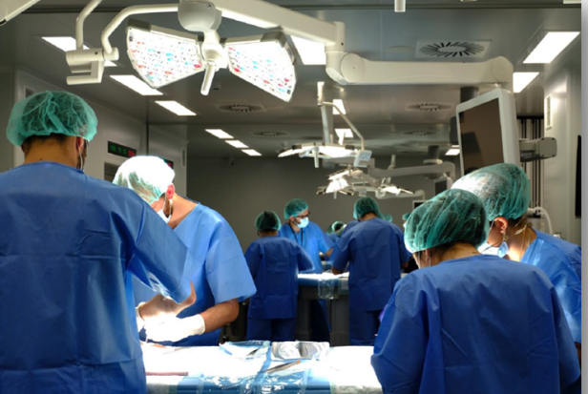
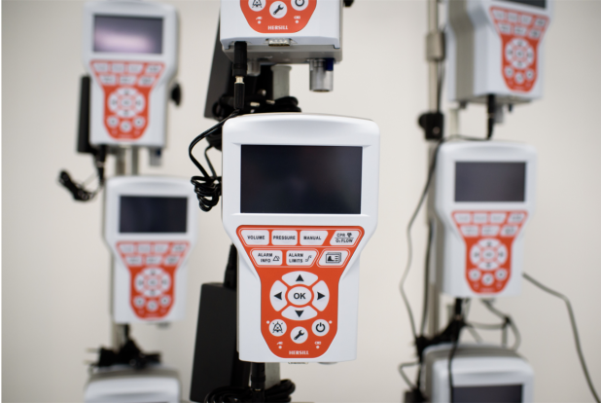
The Can Ruti Campus: activity numbers (2020)
A cluster of
12 Centres
> 80 active research groups
Can Ruti Campus
627 active
clinical trials
946
publications
270
active projects
34 active
patent families

Slide 9

Germans Trias University Hospital
At the centre of Can Ruti Campus

Slide 10
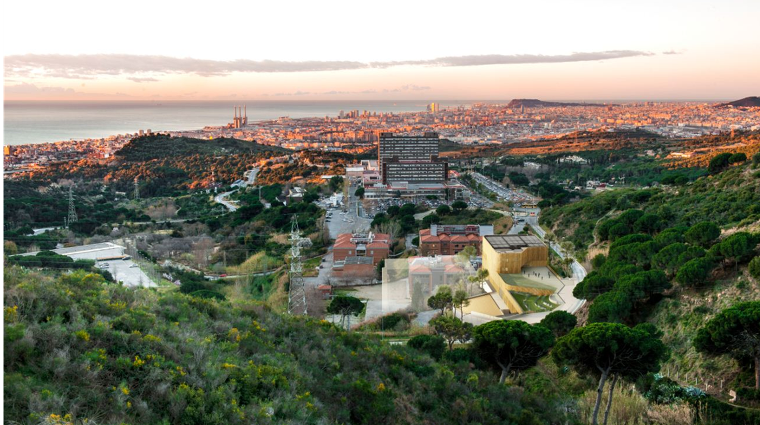
Now, at the heart of our organization...

Slide 11

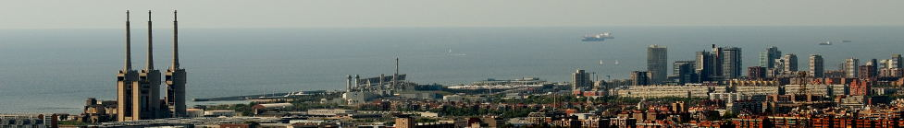
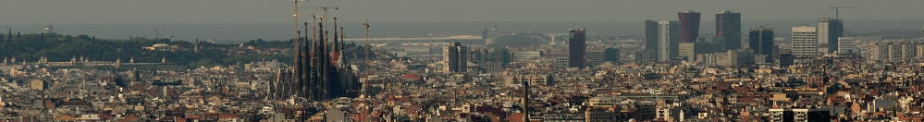

Germans Trias i Pujol University Hospital
Our mission: Health for 800,000 people
33,174 discharges
17,176 surg. episodes
123,514 emergencies
3 new integrated care departments (last 2 years)
>200 robotic surg. episodes
4 transplantation programs
Germans Trias Hospital
4,124 professionals
283 medical residents
1,457 health sciences students
Economic sustainability
(No deficit last 5 years)
>94% Hospital objectives achievement last 5 years
Data collected 2021

Slide 12

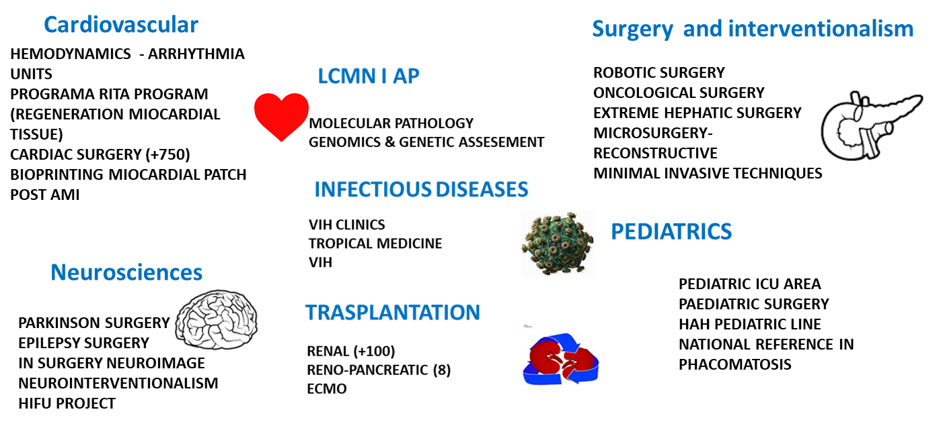
High complexity and excellence areas
Germans Trias Hospital

Slide 13
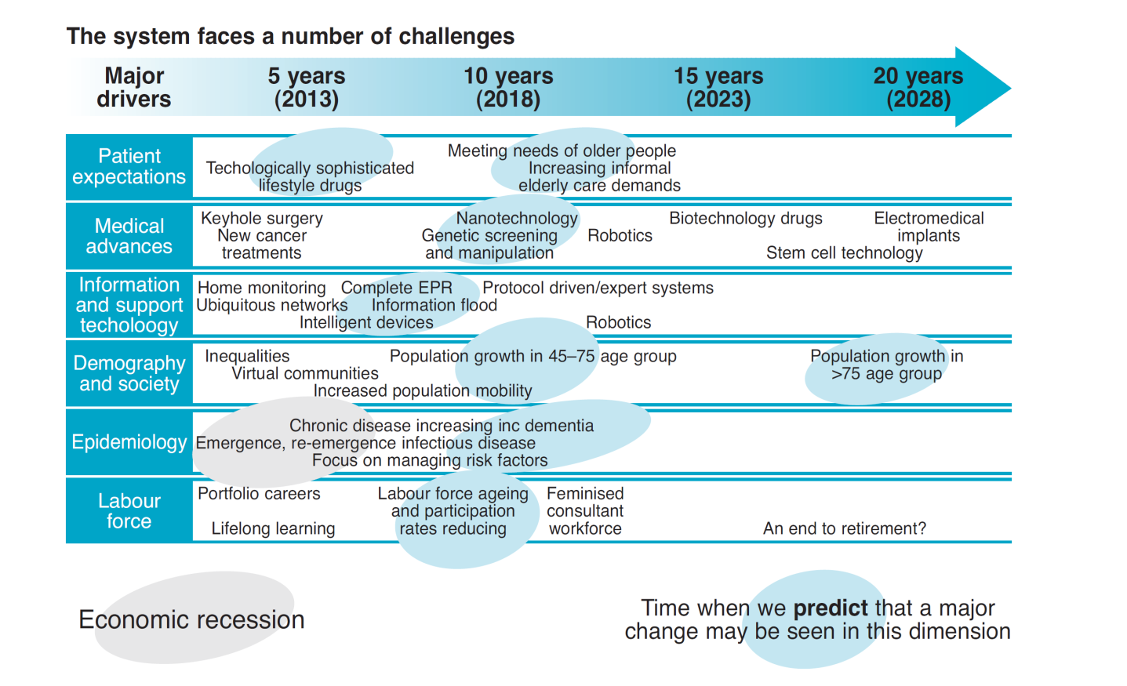
How fast the paradigm changes
Germans Trias Hospital
Source: Royal College of Physicians. Future physician: changing doctors in changing times. Report of a working party. London: RCP, 2010.

Slide 14
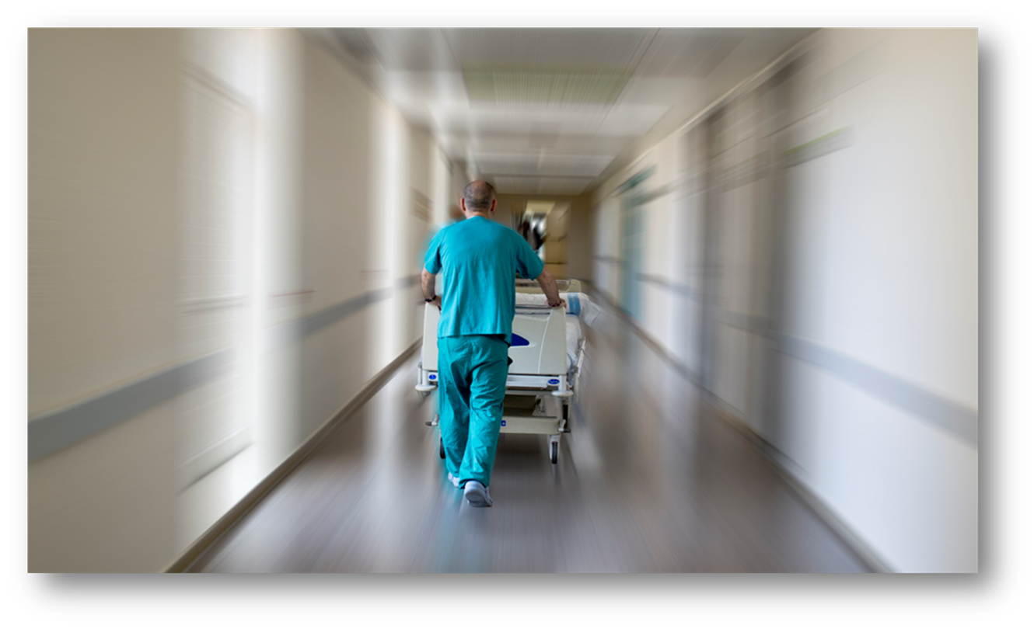
Our concept of clinical innovation
First, we must find the way we would like to manage healthcare.
Germans Trias Hospital
Then, we search for the tools which can help us to achieve our purpose

Slide 15
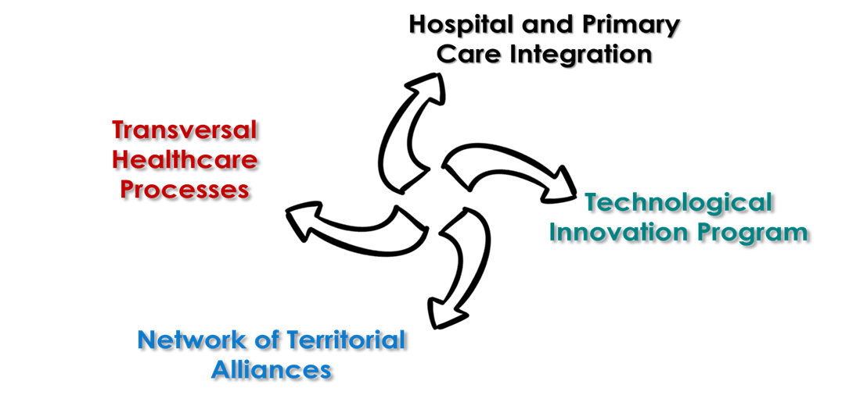
La innovació clínica com a motor de canvi del model assistencial
Germans Trias Hospital

Slide 16
Clinical Innovation in our territory. Impact of change: 2014-2021
1,420 (14%)
Involved professionals
79M€ (13.7%)
Budget of our organisation
>2,300
Surg. episodes shared in other network hospitals
78
Launched projects in 7 years
18
Clinical Units shared with network hospitals
5
Strategic areas of technological innovation prioritized
Germans Trias Hospital
14
Projects with positive health results
73 M€
Investment innovation funds 2021-2023
>140
Internal Research Grants in 9 years

Slide 17

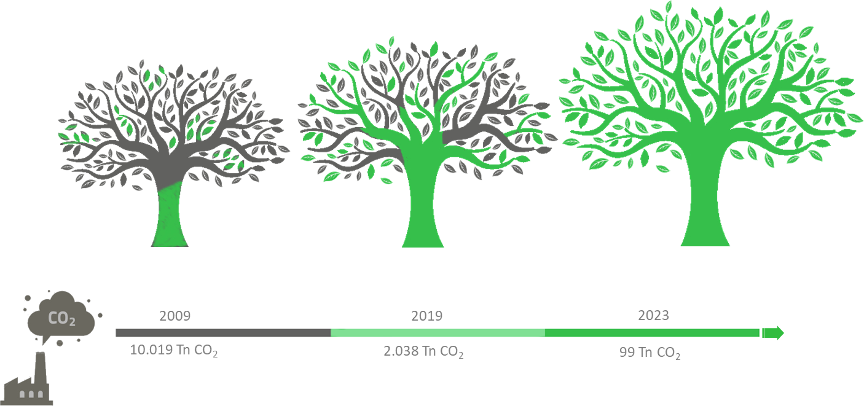
A Hospital commited to the Green Deal:
Towards total decarbonisation
Germans Trias Hospital

Slide 18

Can Ruti Campus:
Improving health
Increasing knowledge
Promoting innovation

Slide 19
Germans Trias University Hospital
Three areas of excellence:
Dr. Roger Paredes (Head of Infectious Diseases Department)
Dr. Antoni Bayés (Clinical Director of Institute of Hearth)
Dr. Ignacio Blanco (Clinical Director of Laboratories)

